Slide 1
Sea Girt Recreation 2021 Recap, Program & Project Update Introduce Recreation Commission New Recreation Director, Janeen Yodakis - Fresh Ideas, Community Outreach, High Energy

Slide 3
New Programs and Initiatives: - Inaugural Beach Luau - Sensory Hikes for Kids, Sip & Paint for Adults - Day Trip to NYC Botanical Gardens and Shopping - Holiday window decorating downtown - Participation and Sponsorship of Sea Girt Strolls, Big Band Concert, Craft Markets - Pickleball Clinics / “Live Ball” Tennis

Slide 6
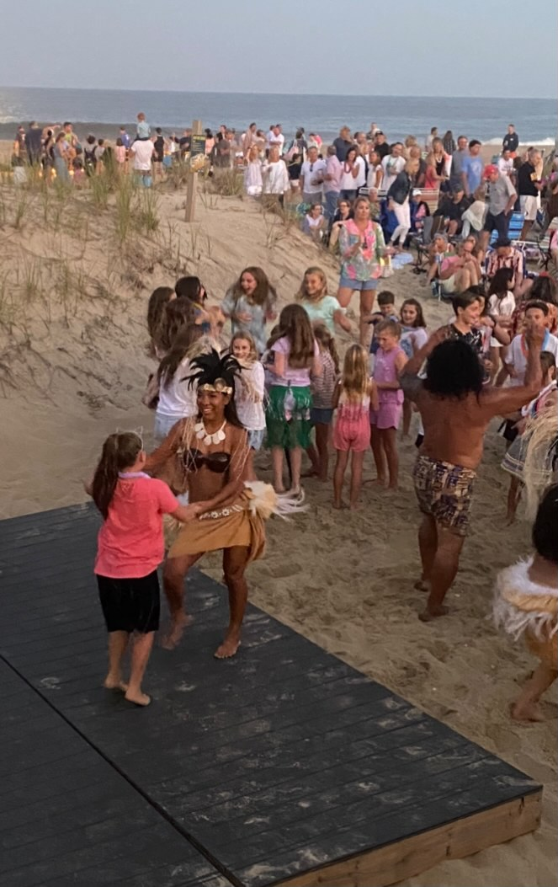

Slide 7
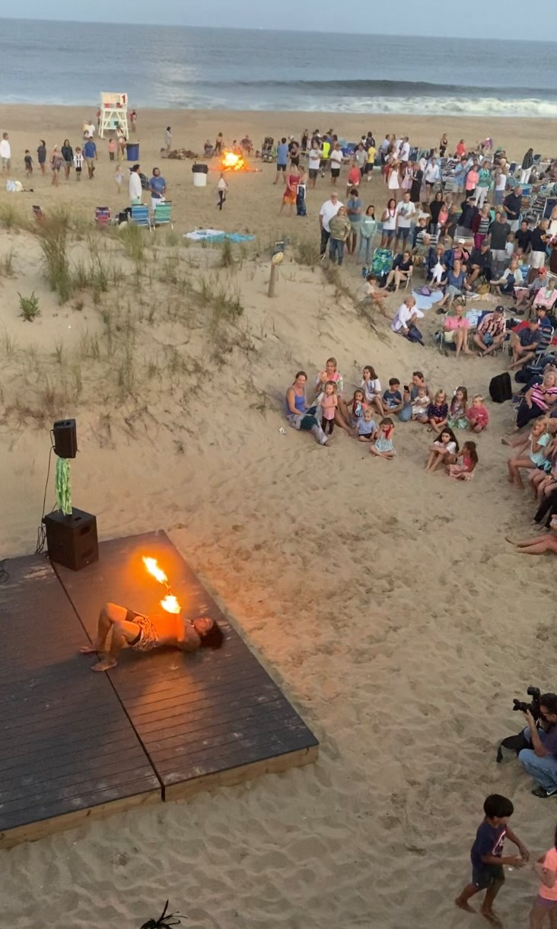

Slide 8
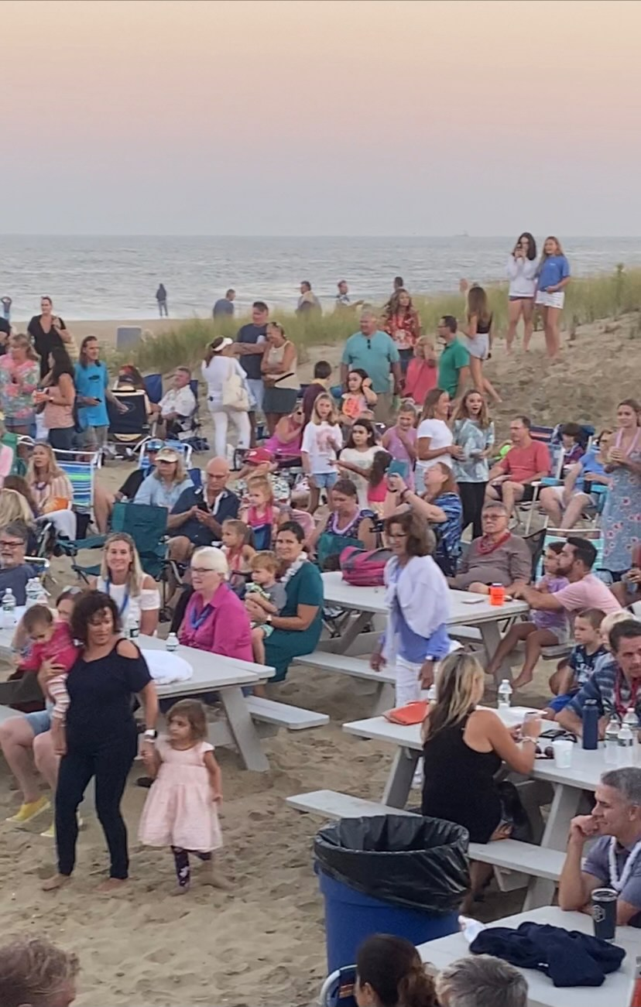

Slide 9
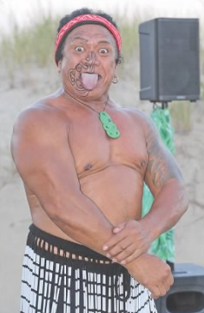

Slide 10
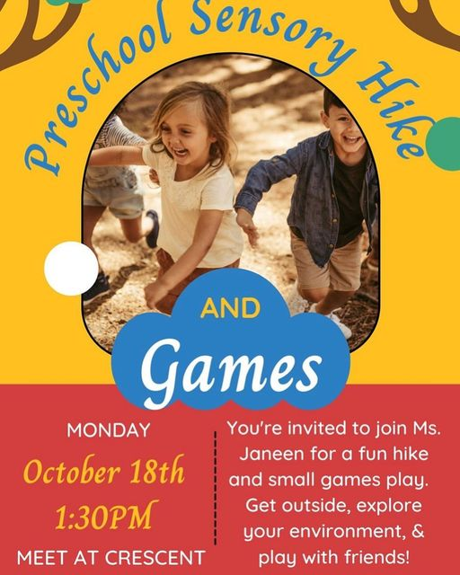

Slide 11
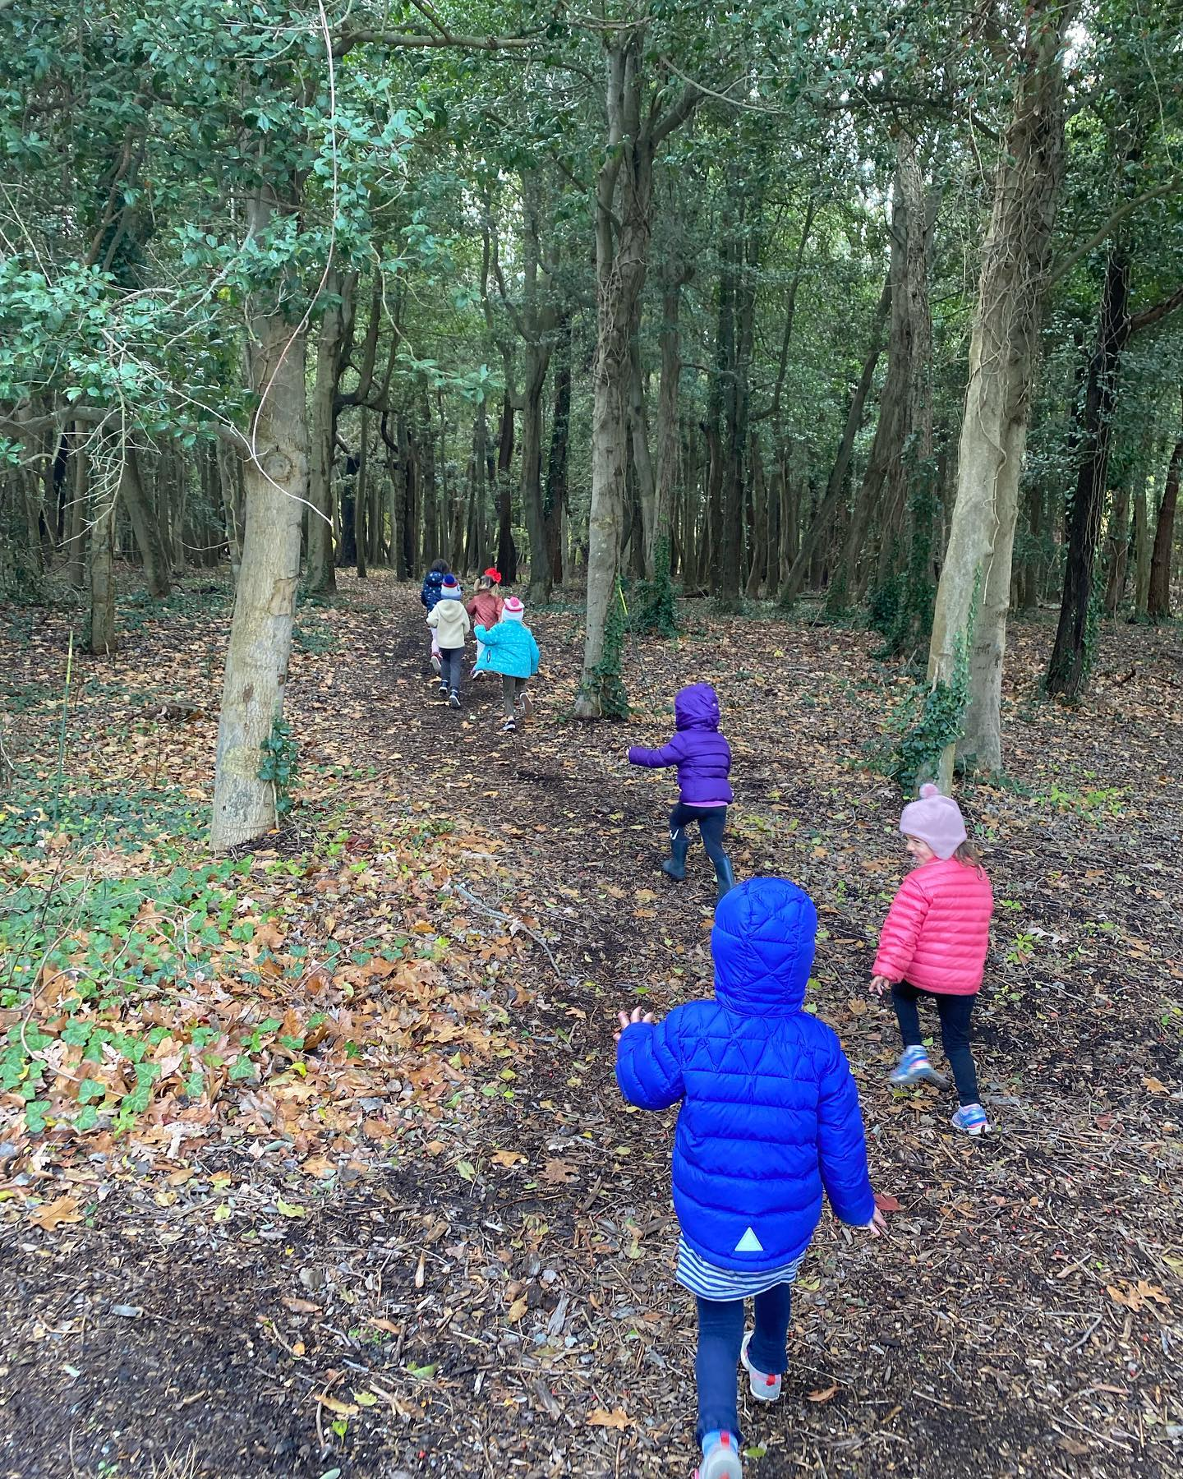

Slide 12
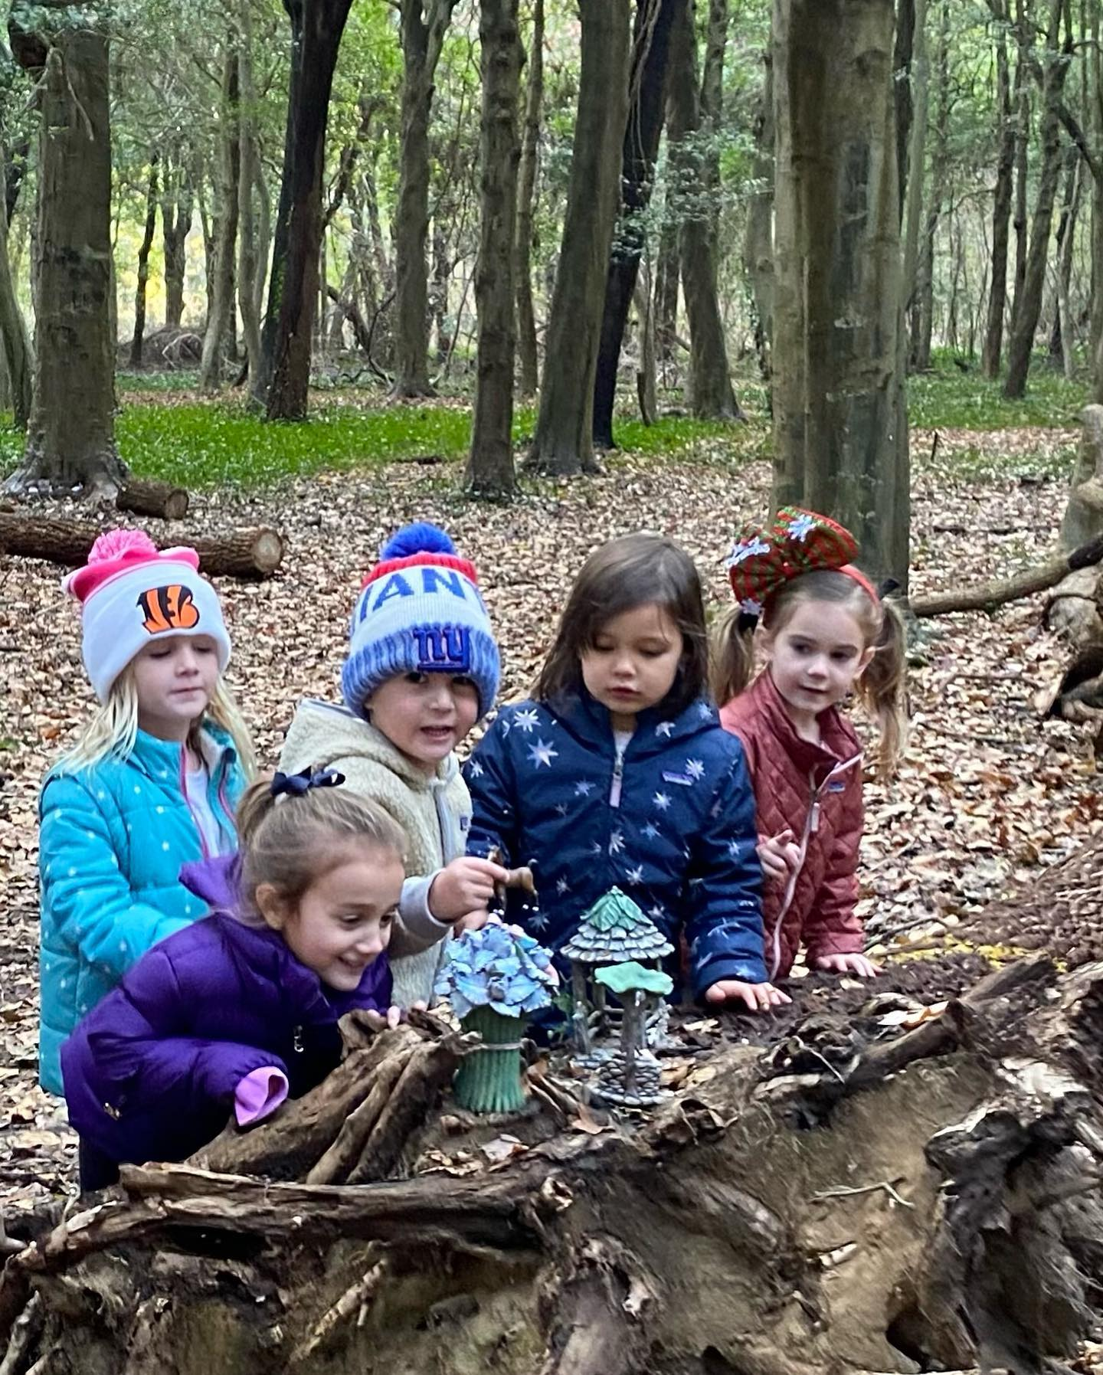

Slide 13
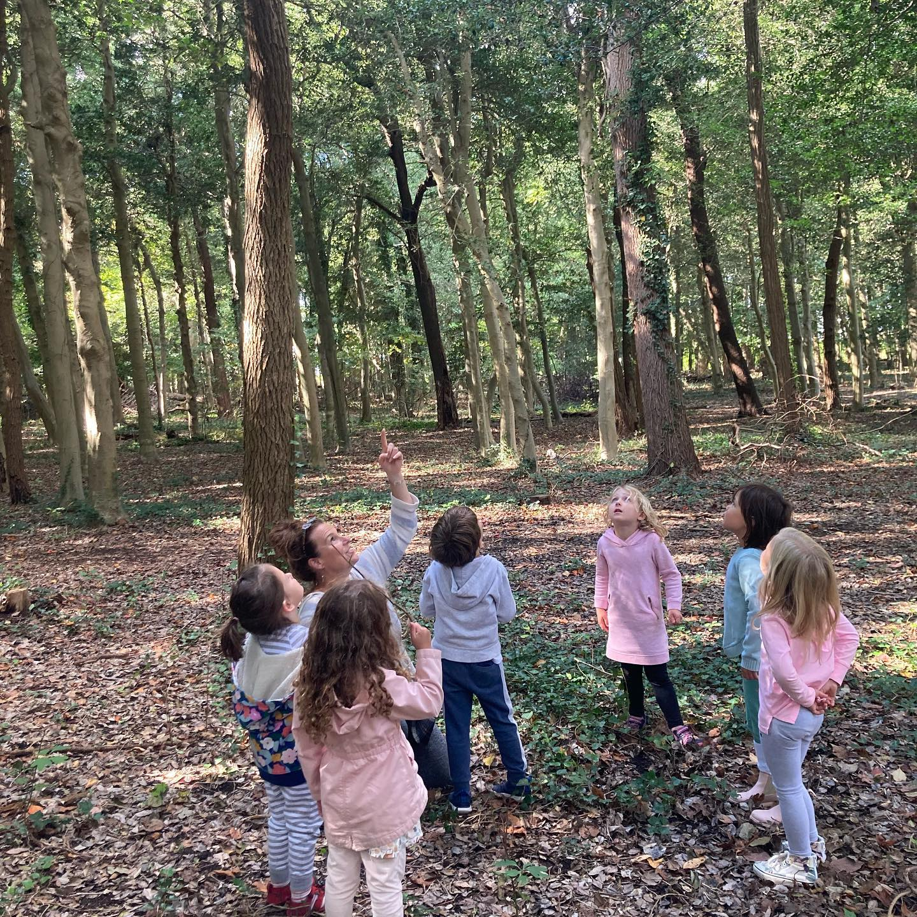

Slide 15
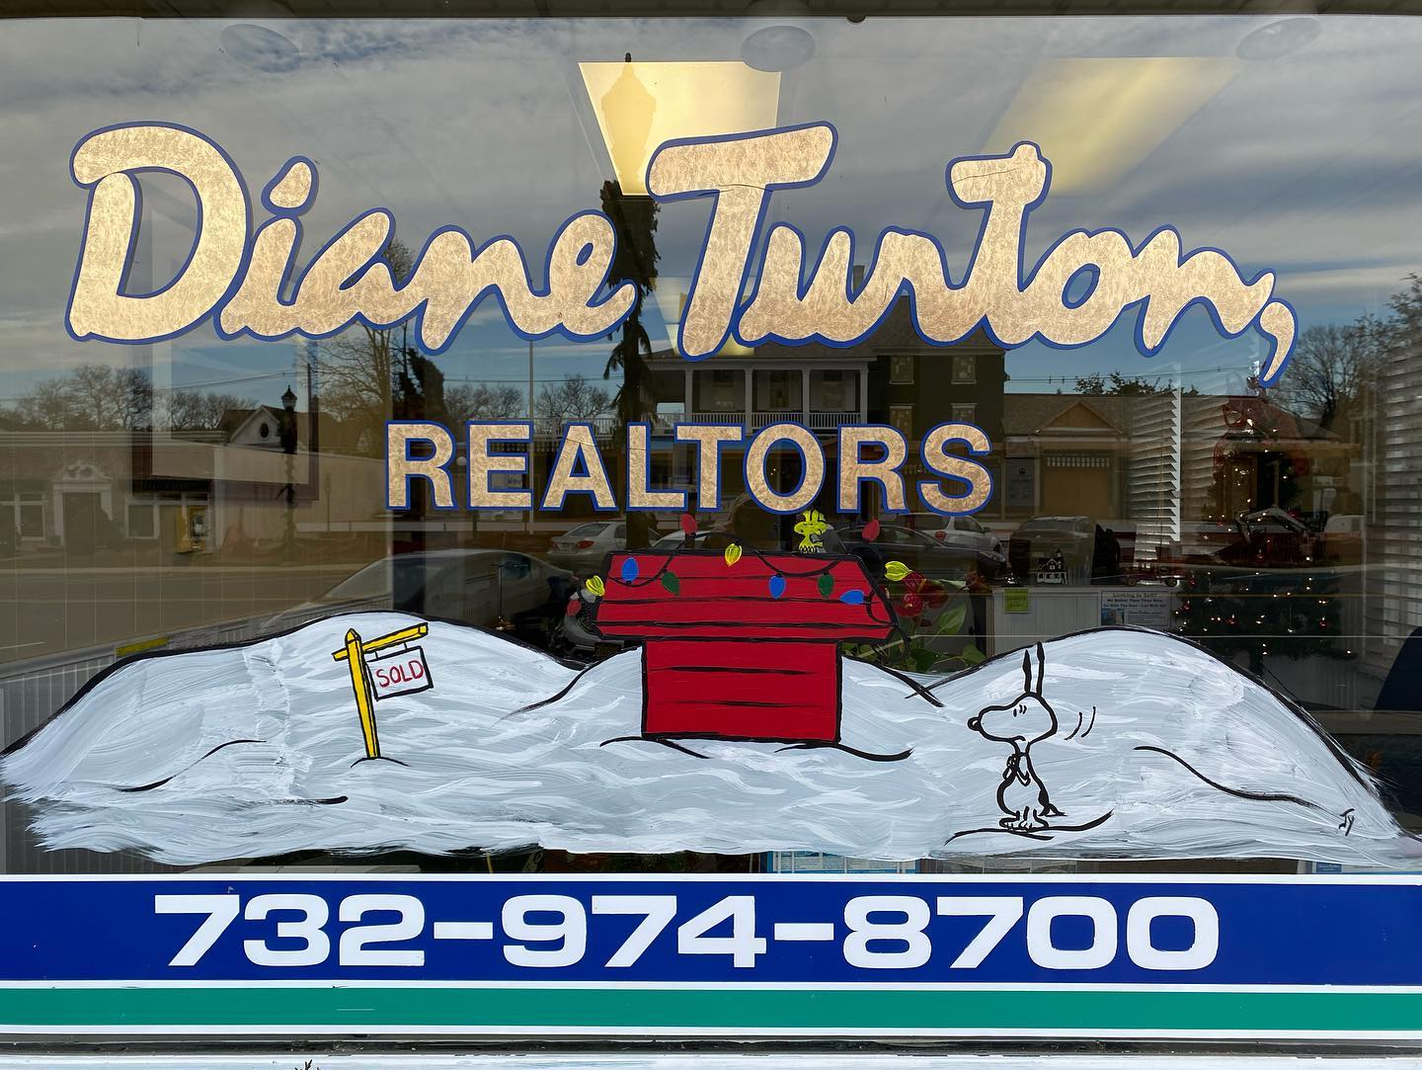

Slide 16
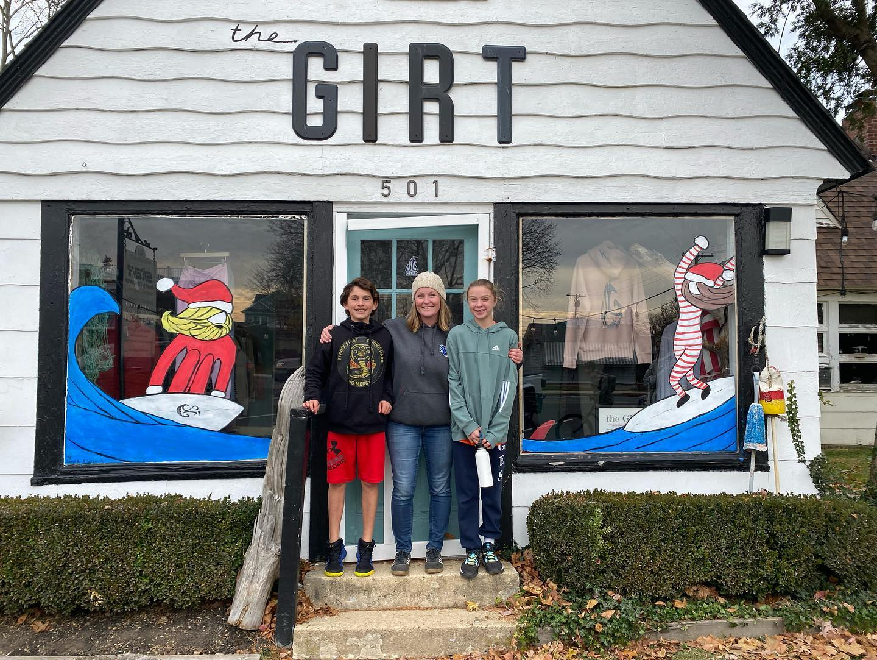

Slide 17
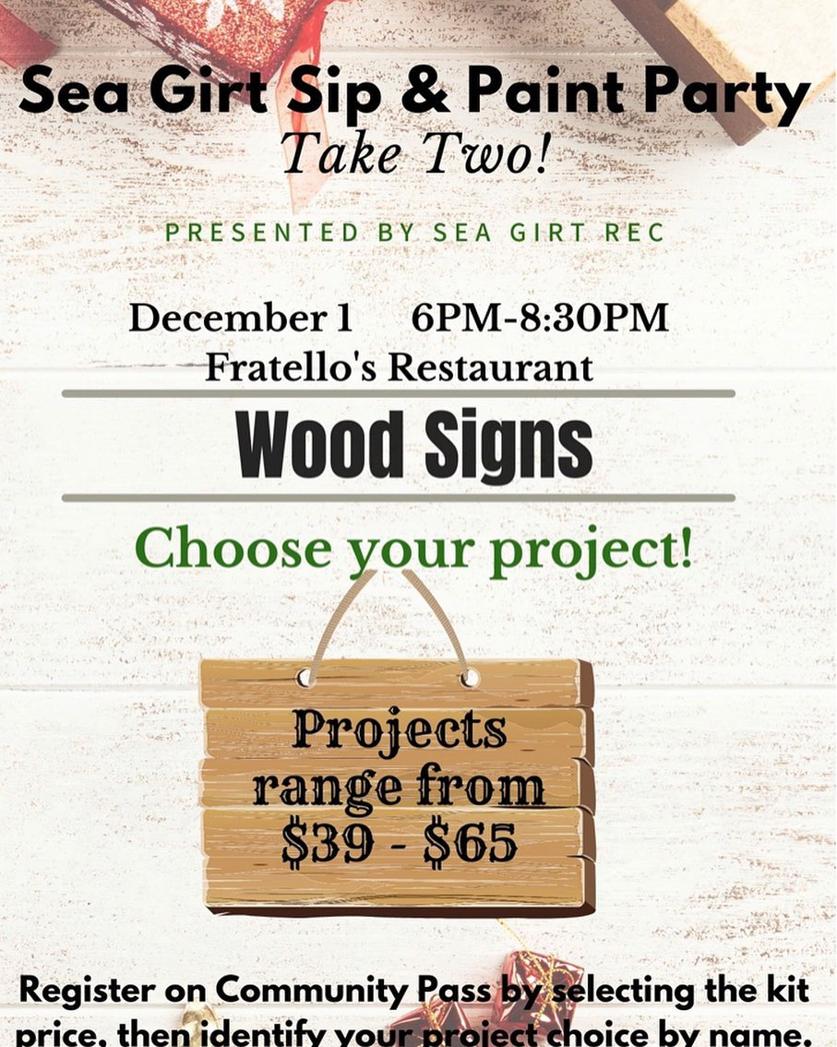

Slide 18
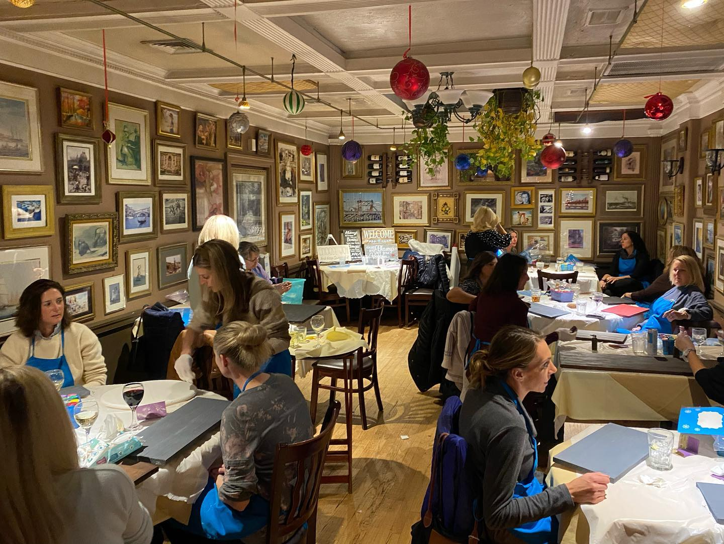

Slide 19
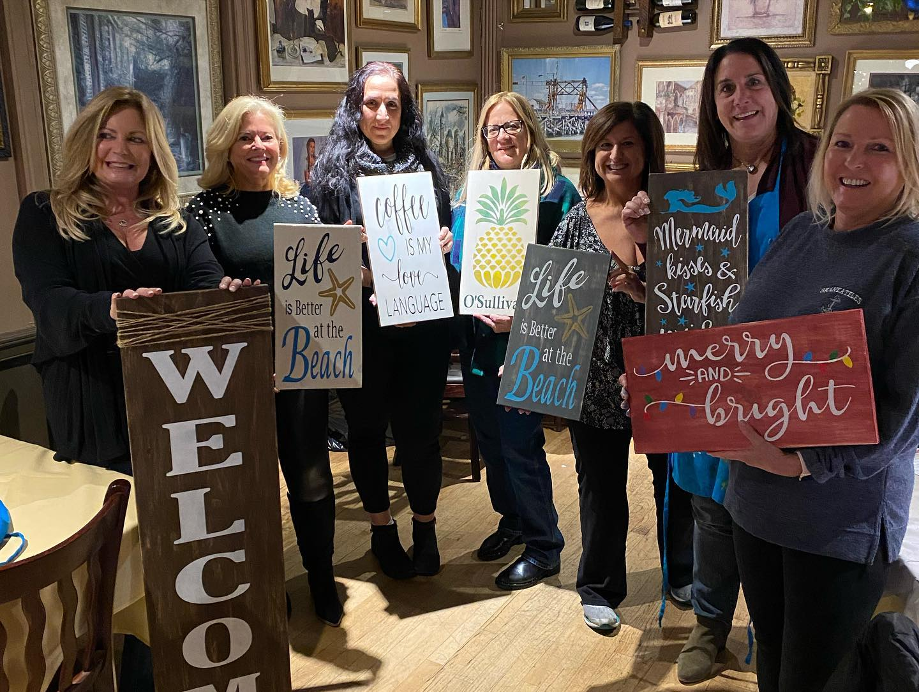

Slide 20
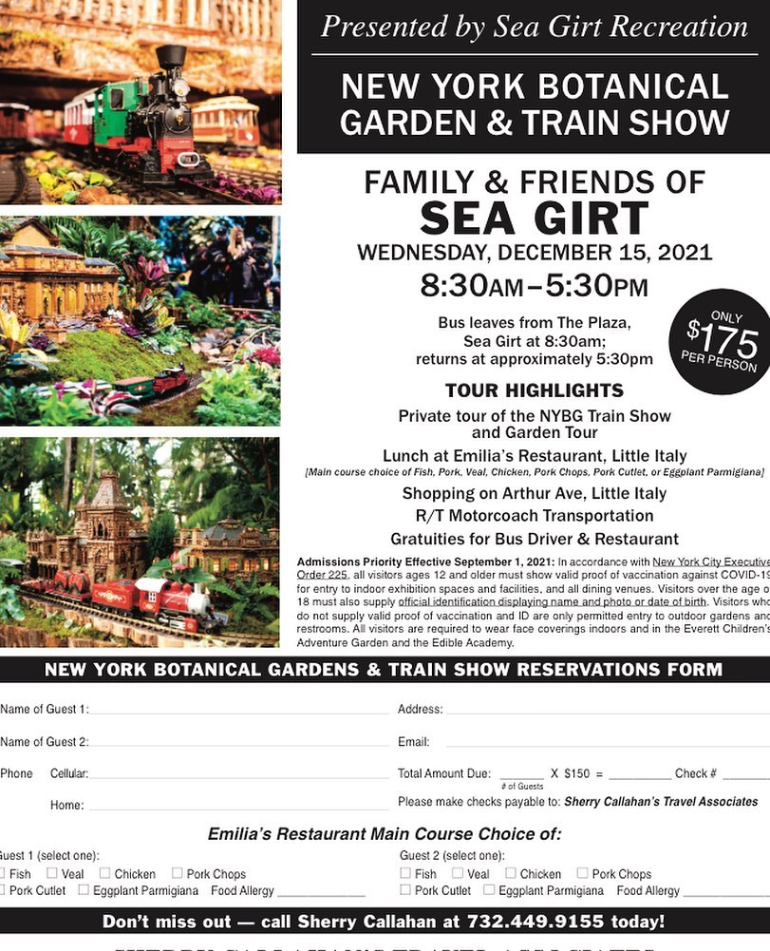

Slide 22
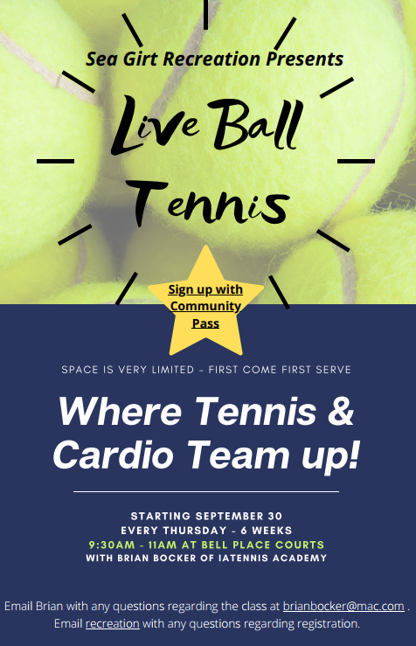

Slide 23
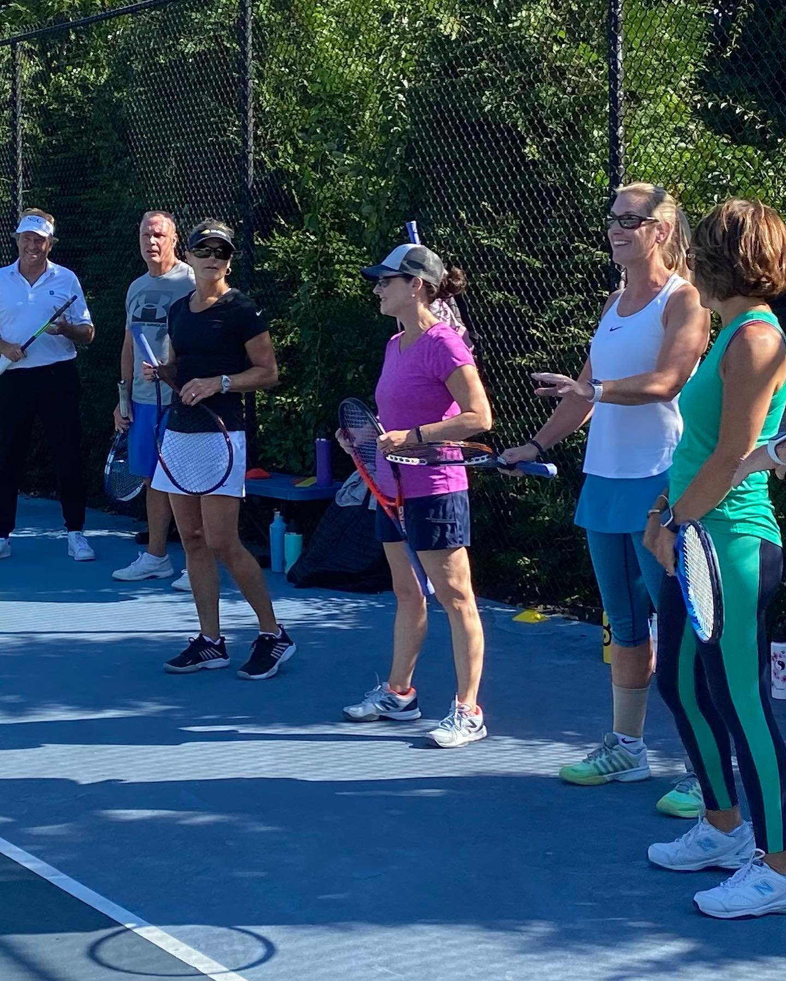

Slide 24
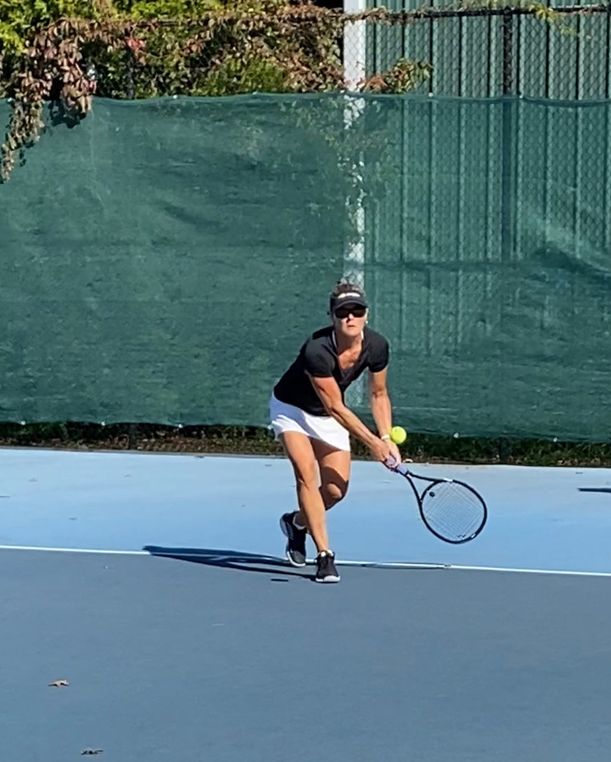

Slide 25
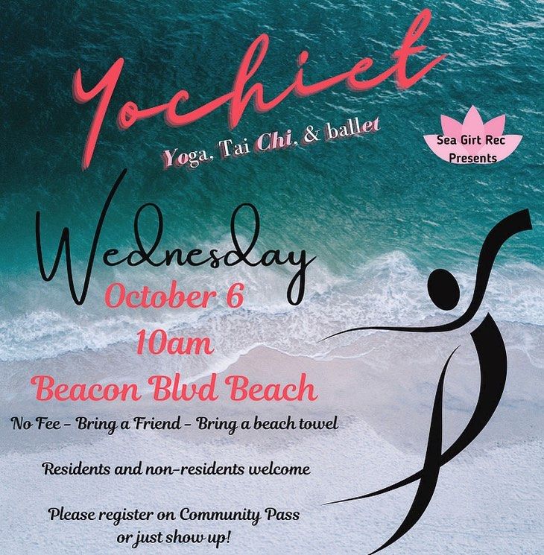

Slide 26
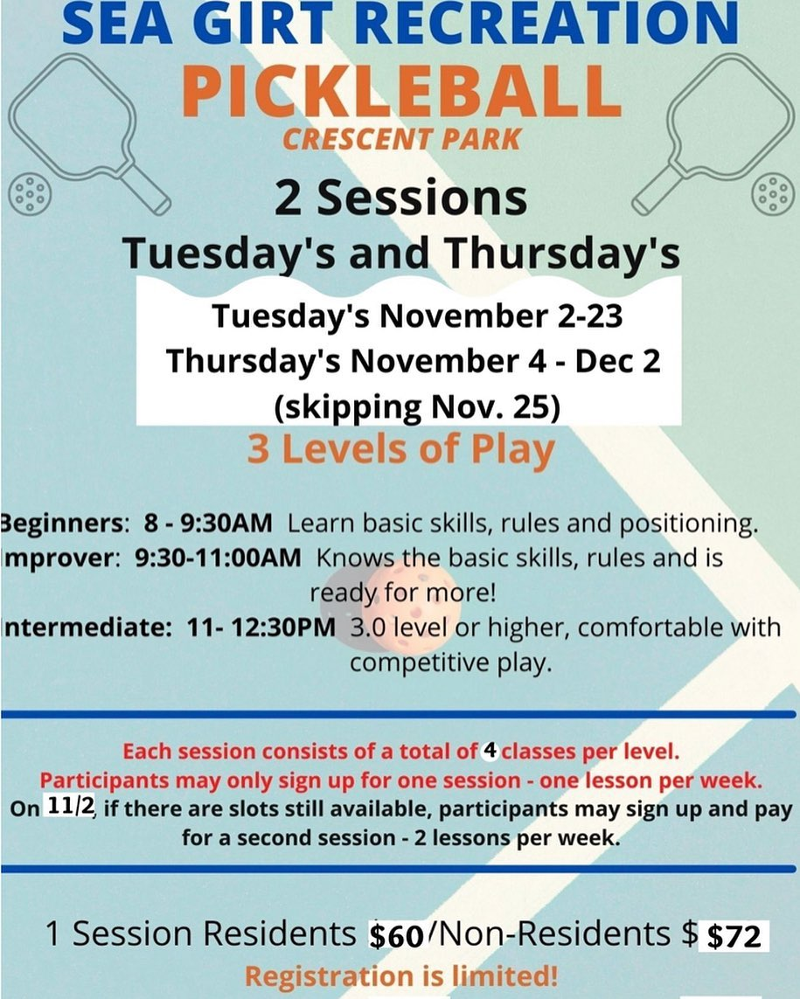

Slide 27
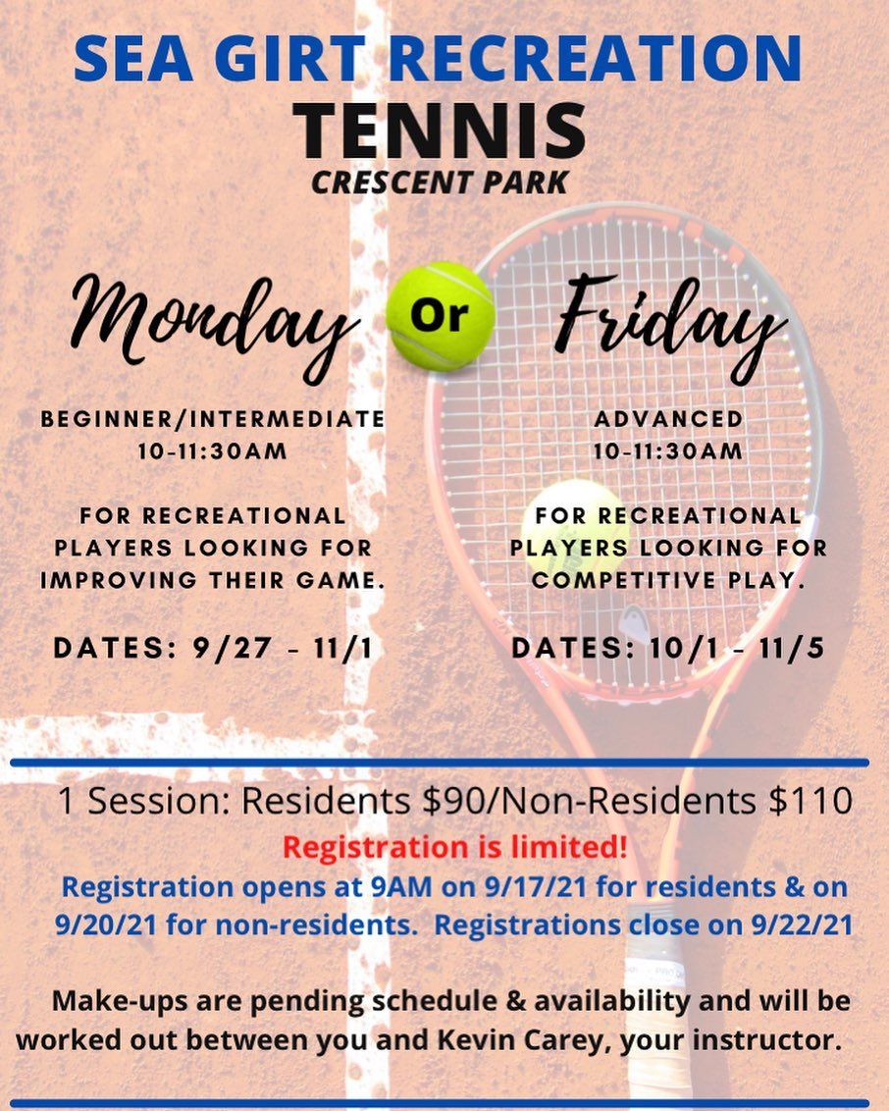

Slide 28
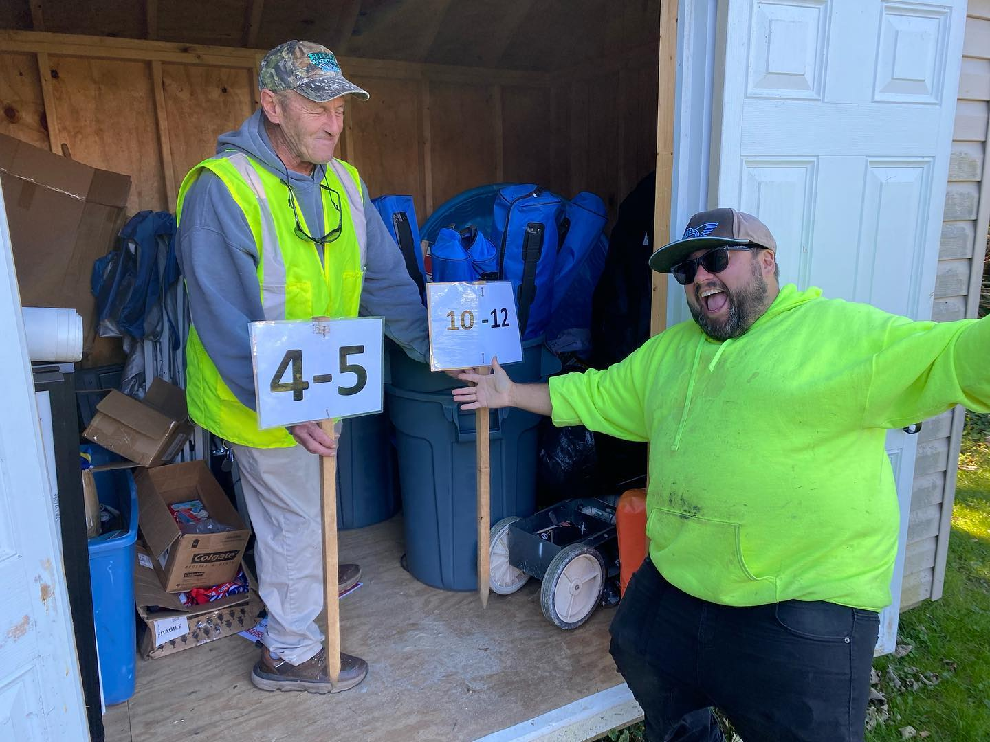

Slide 29
Maintaining and Enhancing the Rec “Staples” - Halloween Hayride, Movies on the Beach - Tree Lighting, Easter Egg Hunt - Summer Rec Camp at Baltimore Park - Summer Beach Volleyball Camp - Guitar and Ukulele on the Beach - Munchkin Soccer, Youth Basketball

Slide 30
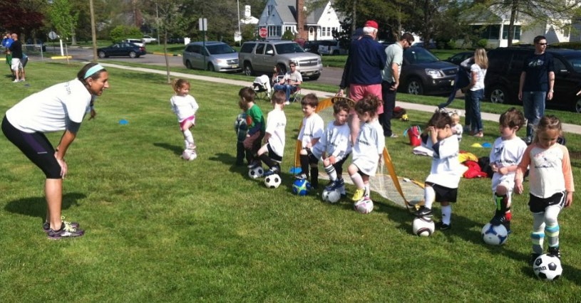

Slide 31
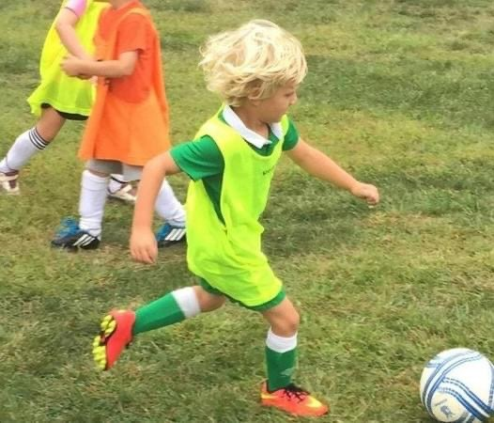

Slide 34
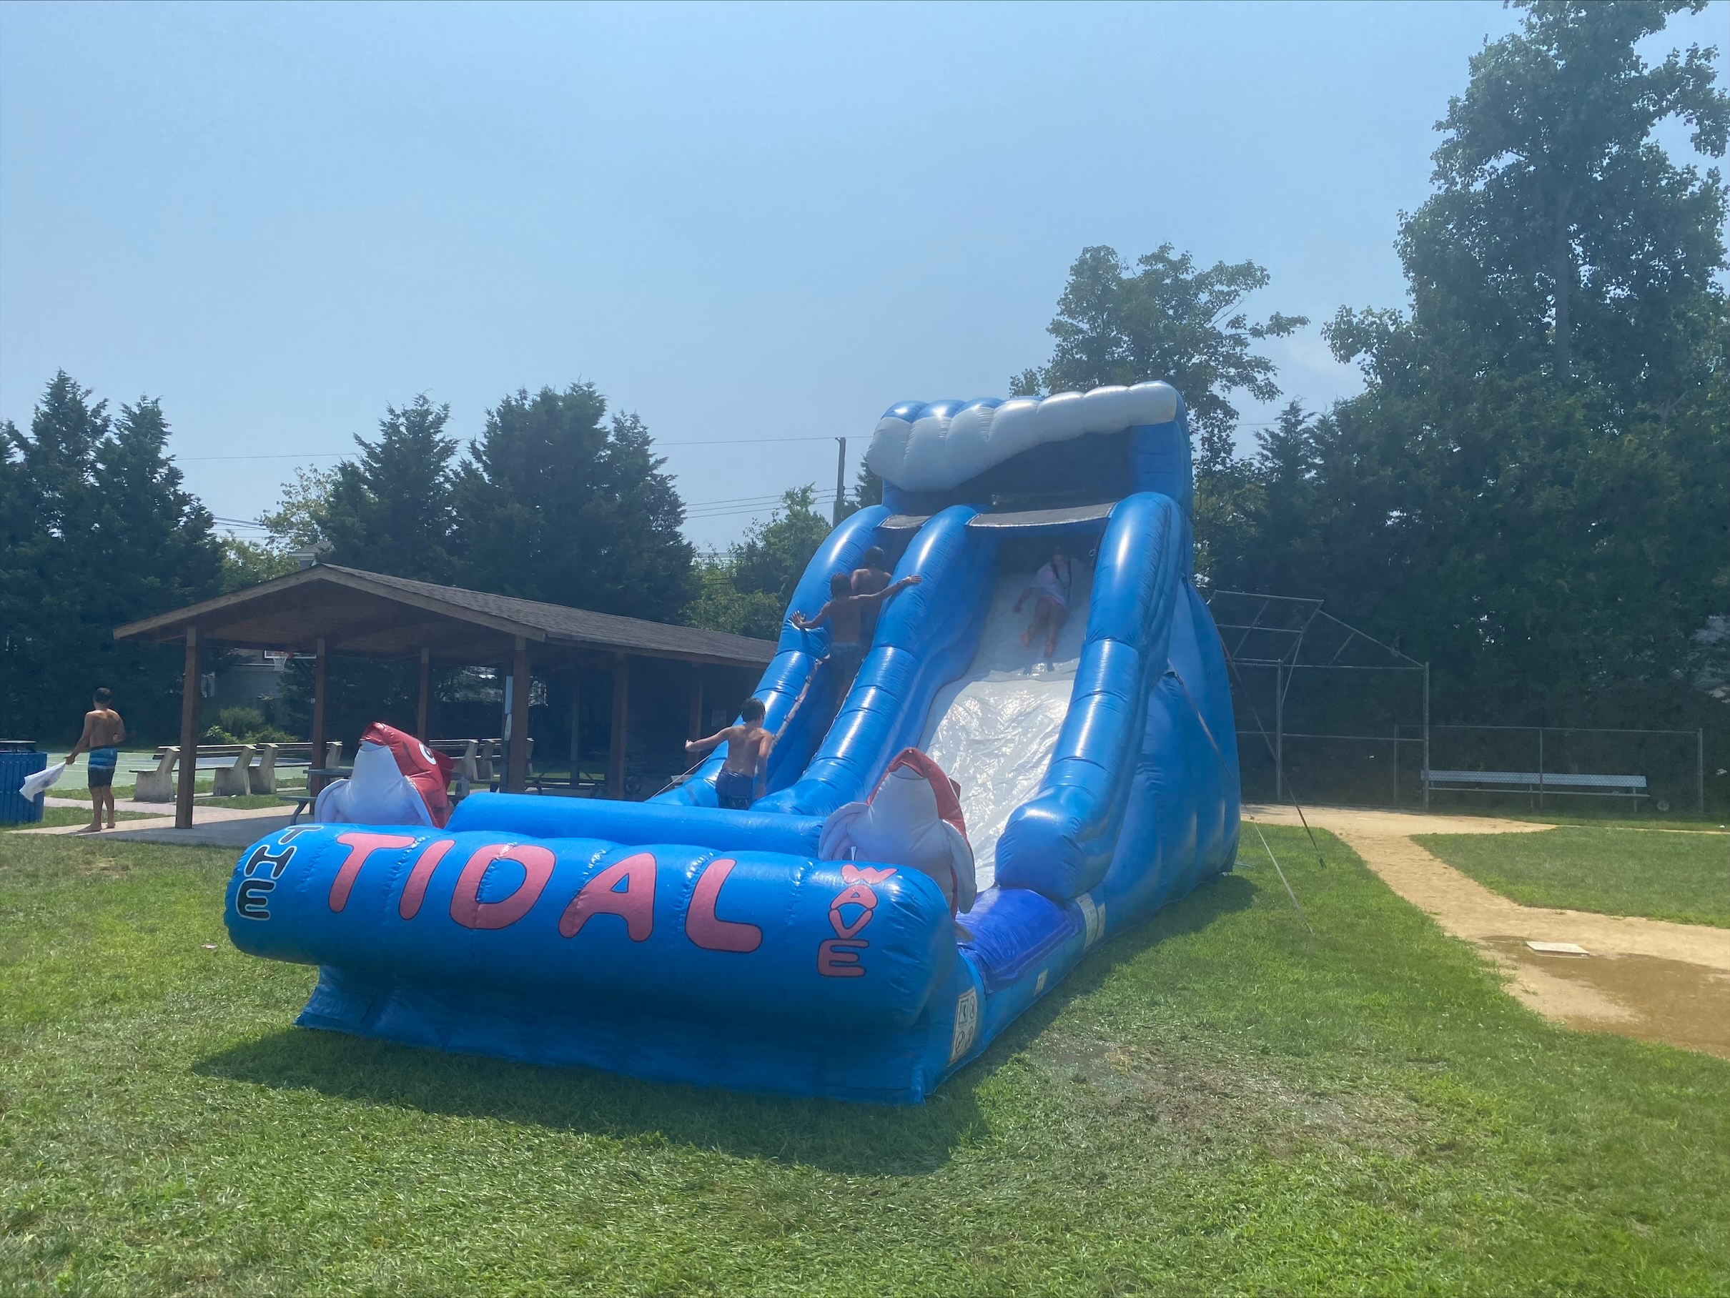

Slide 35
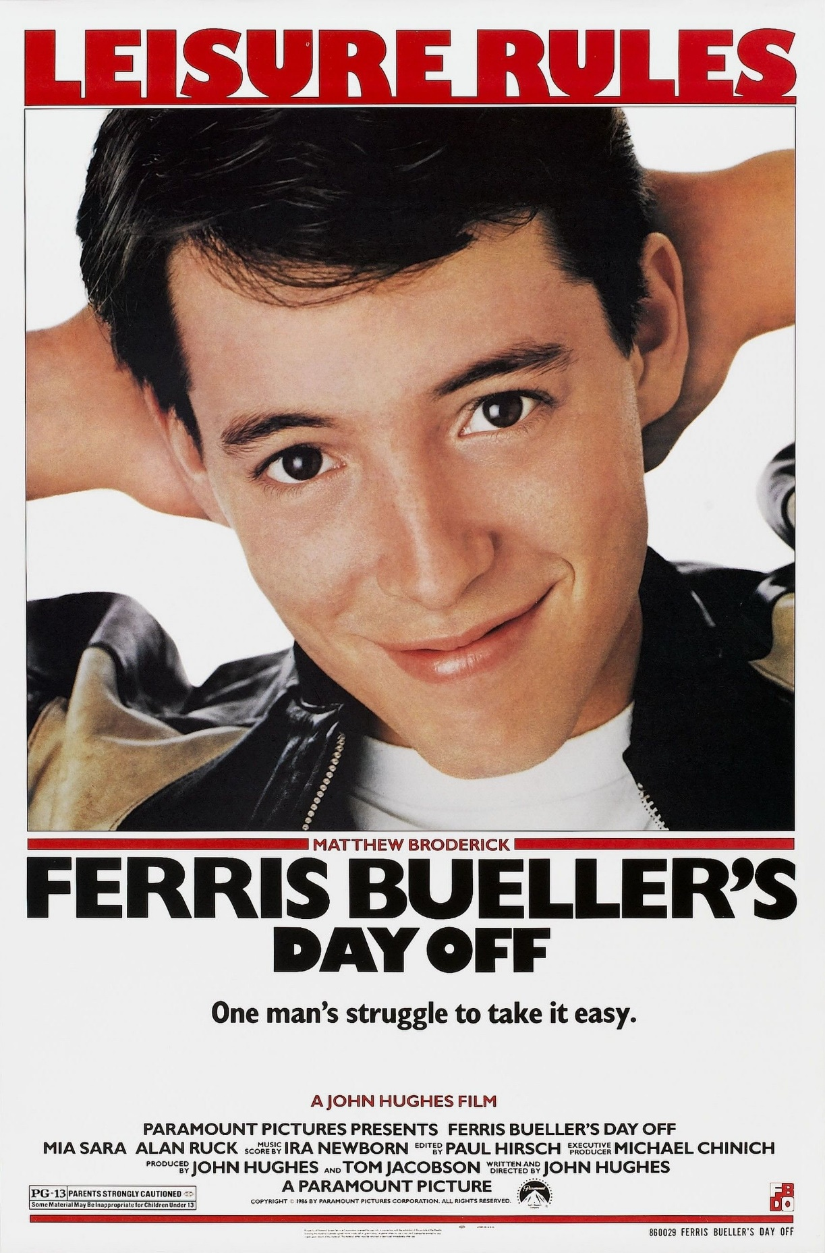

Slide 37
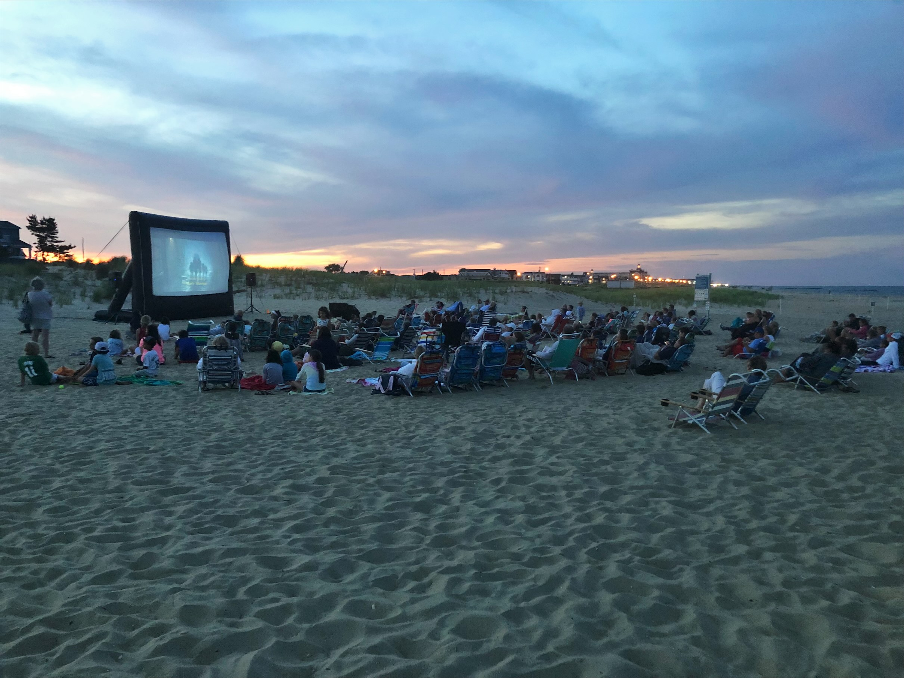

Slide 39
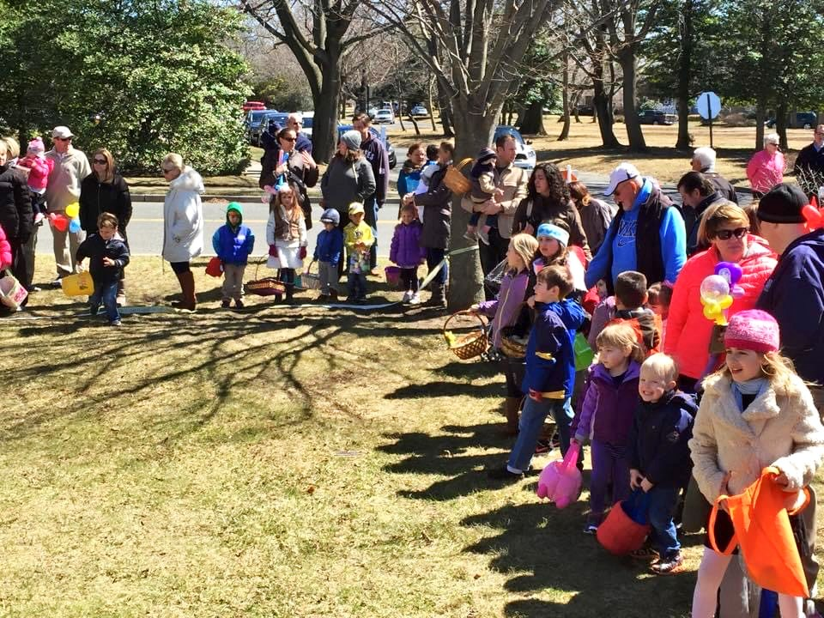

Slide 40
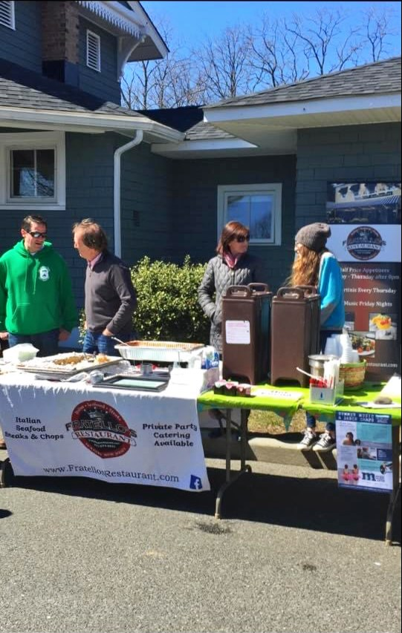

Slide 41
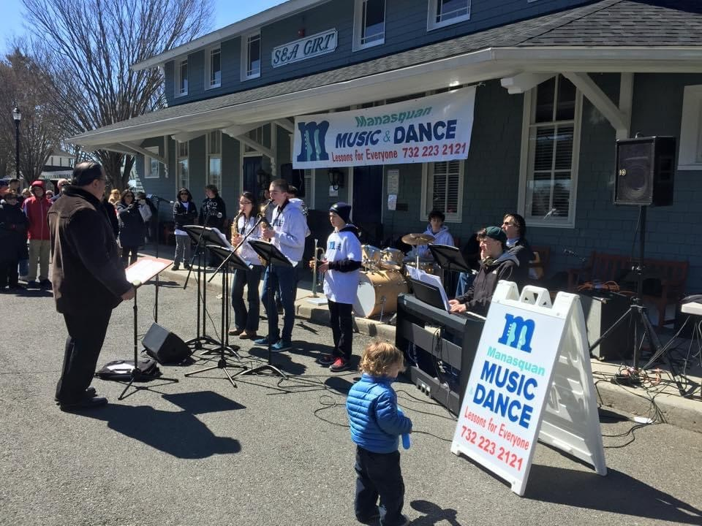

Slide 42
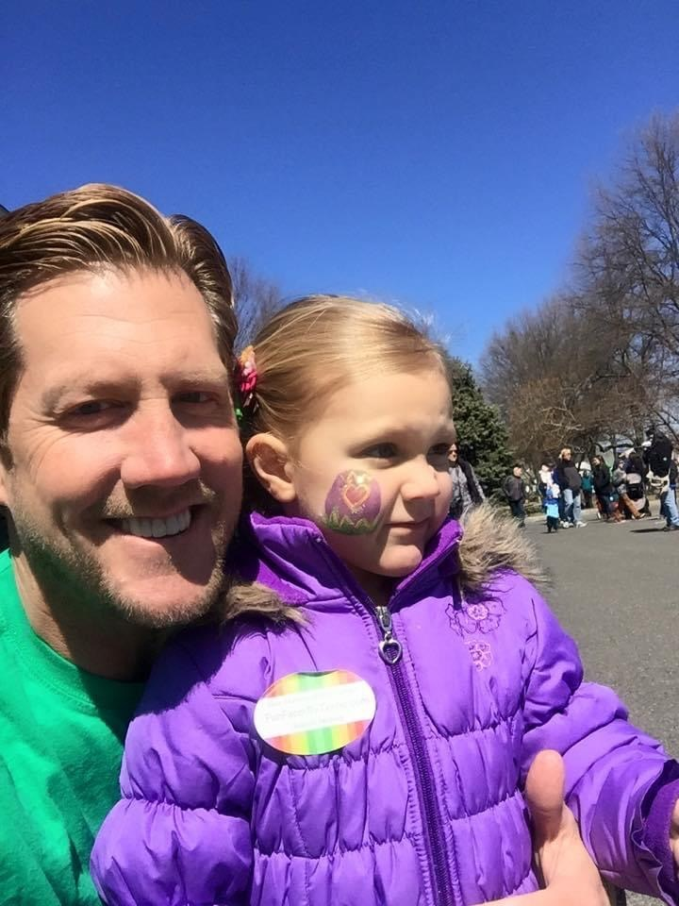

Slide 43
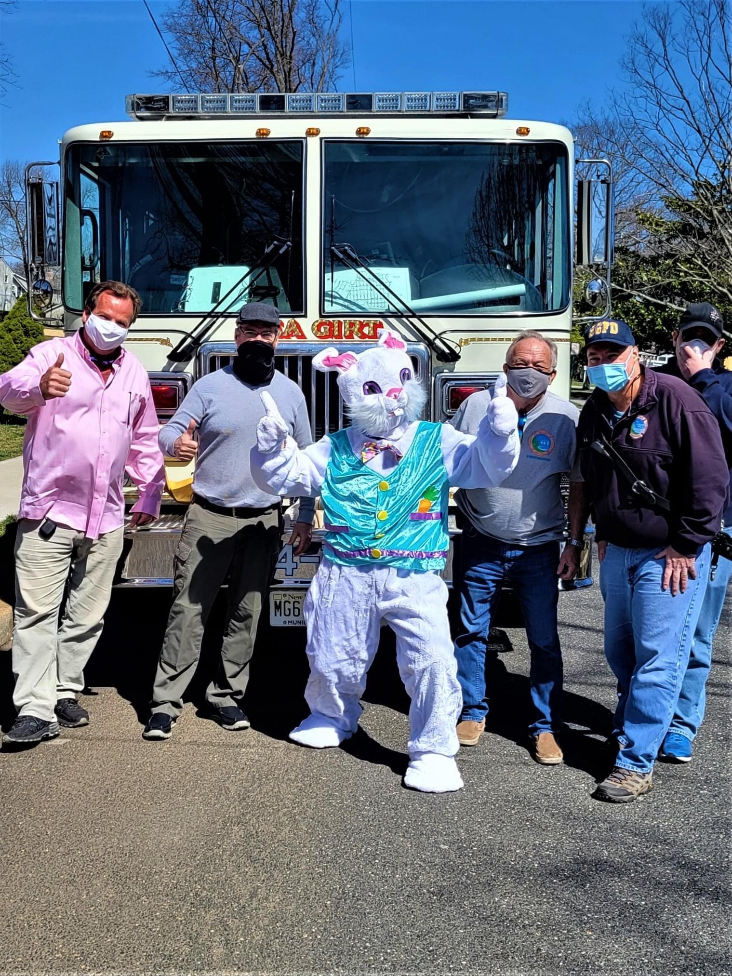

Slide 44
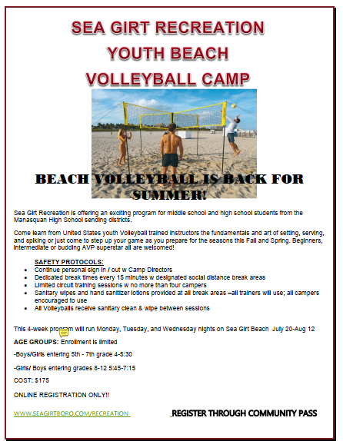

Slide 45
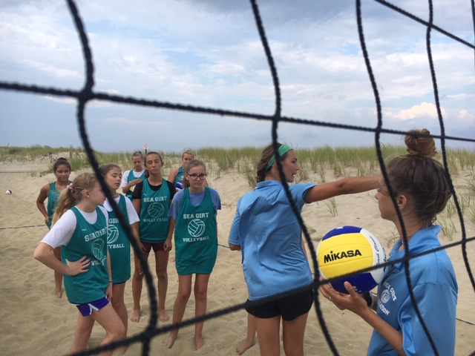

Slide 46
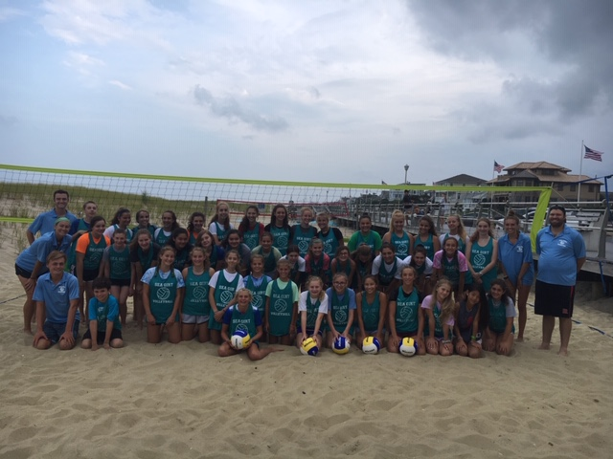

Slide 47
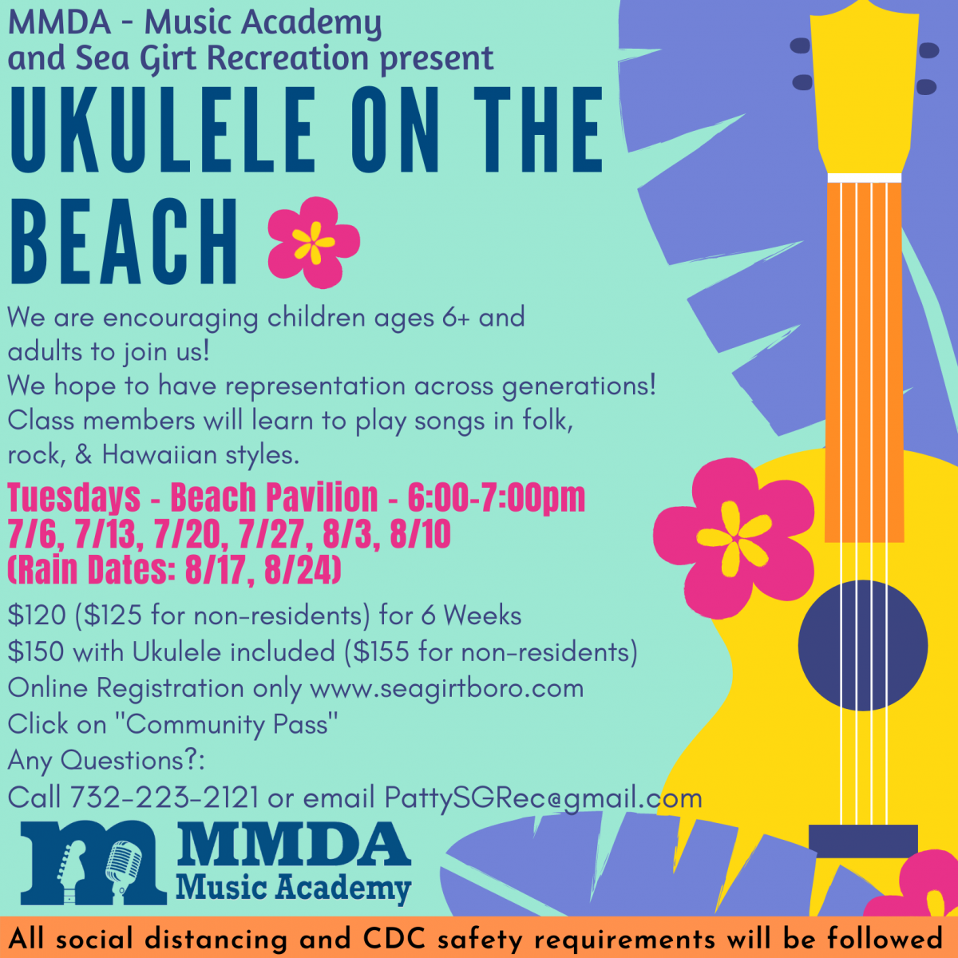

Slide 48
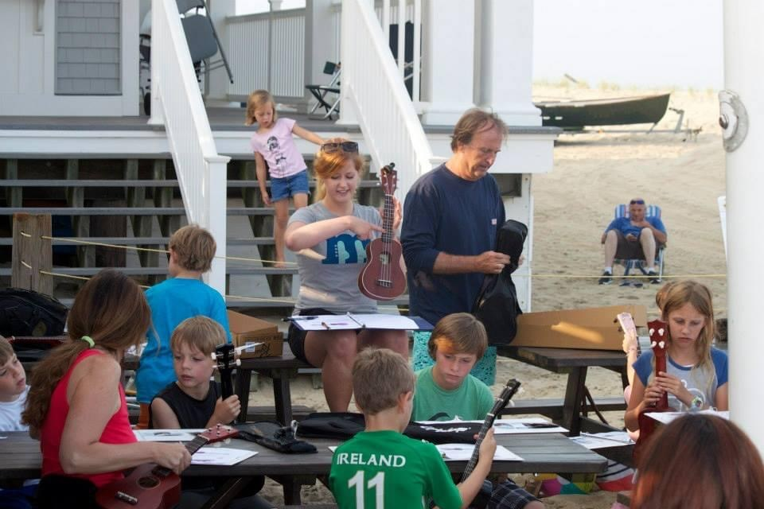

Slide 49
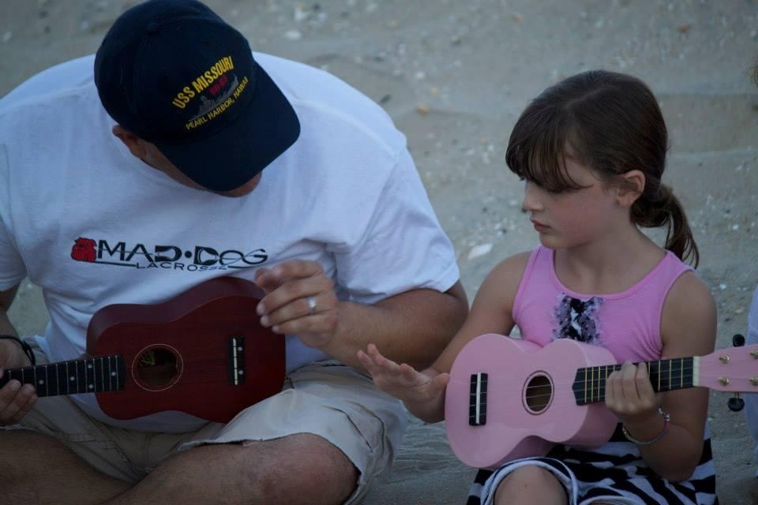

Slide 50
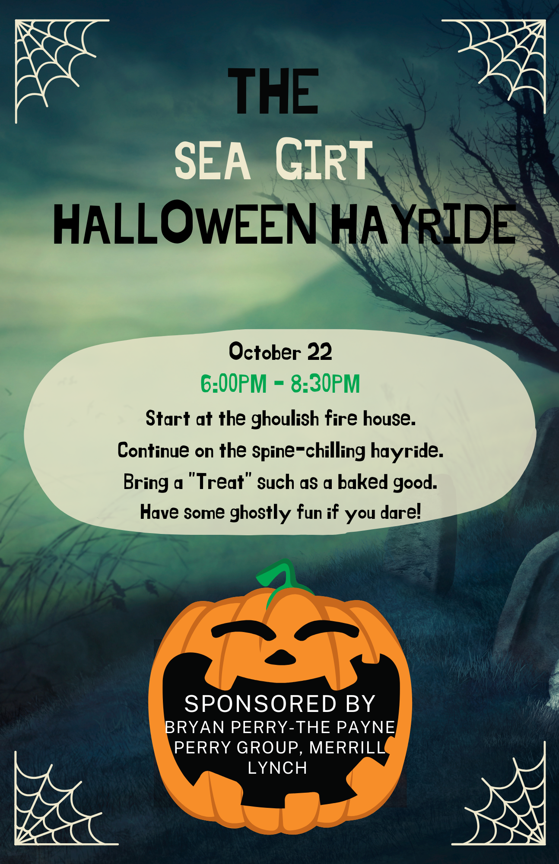

Slide 51
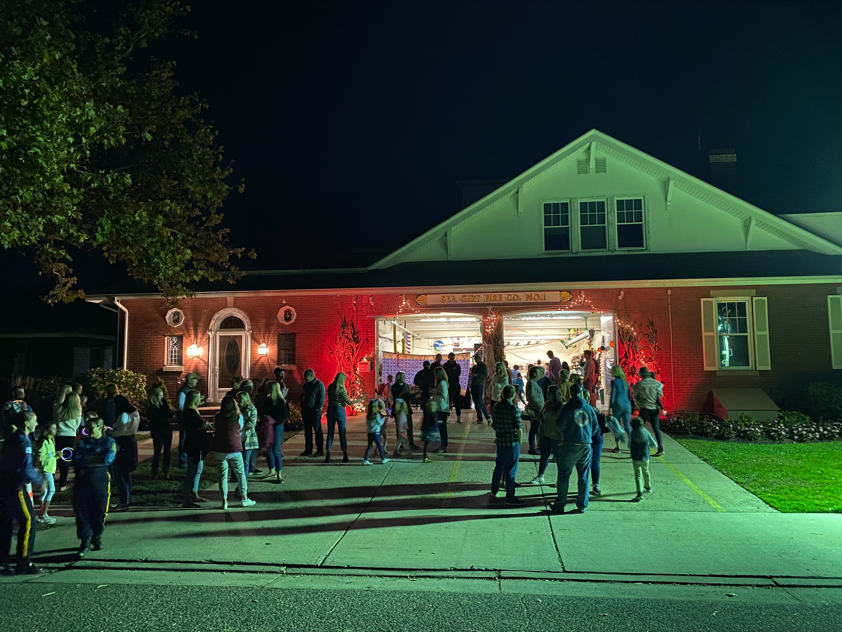

Slide 52
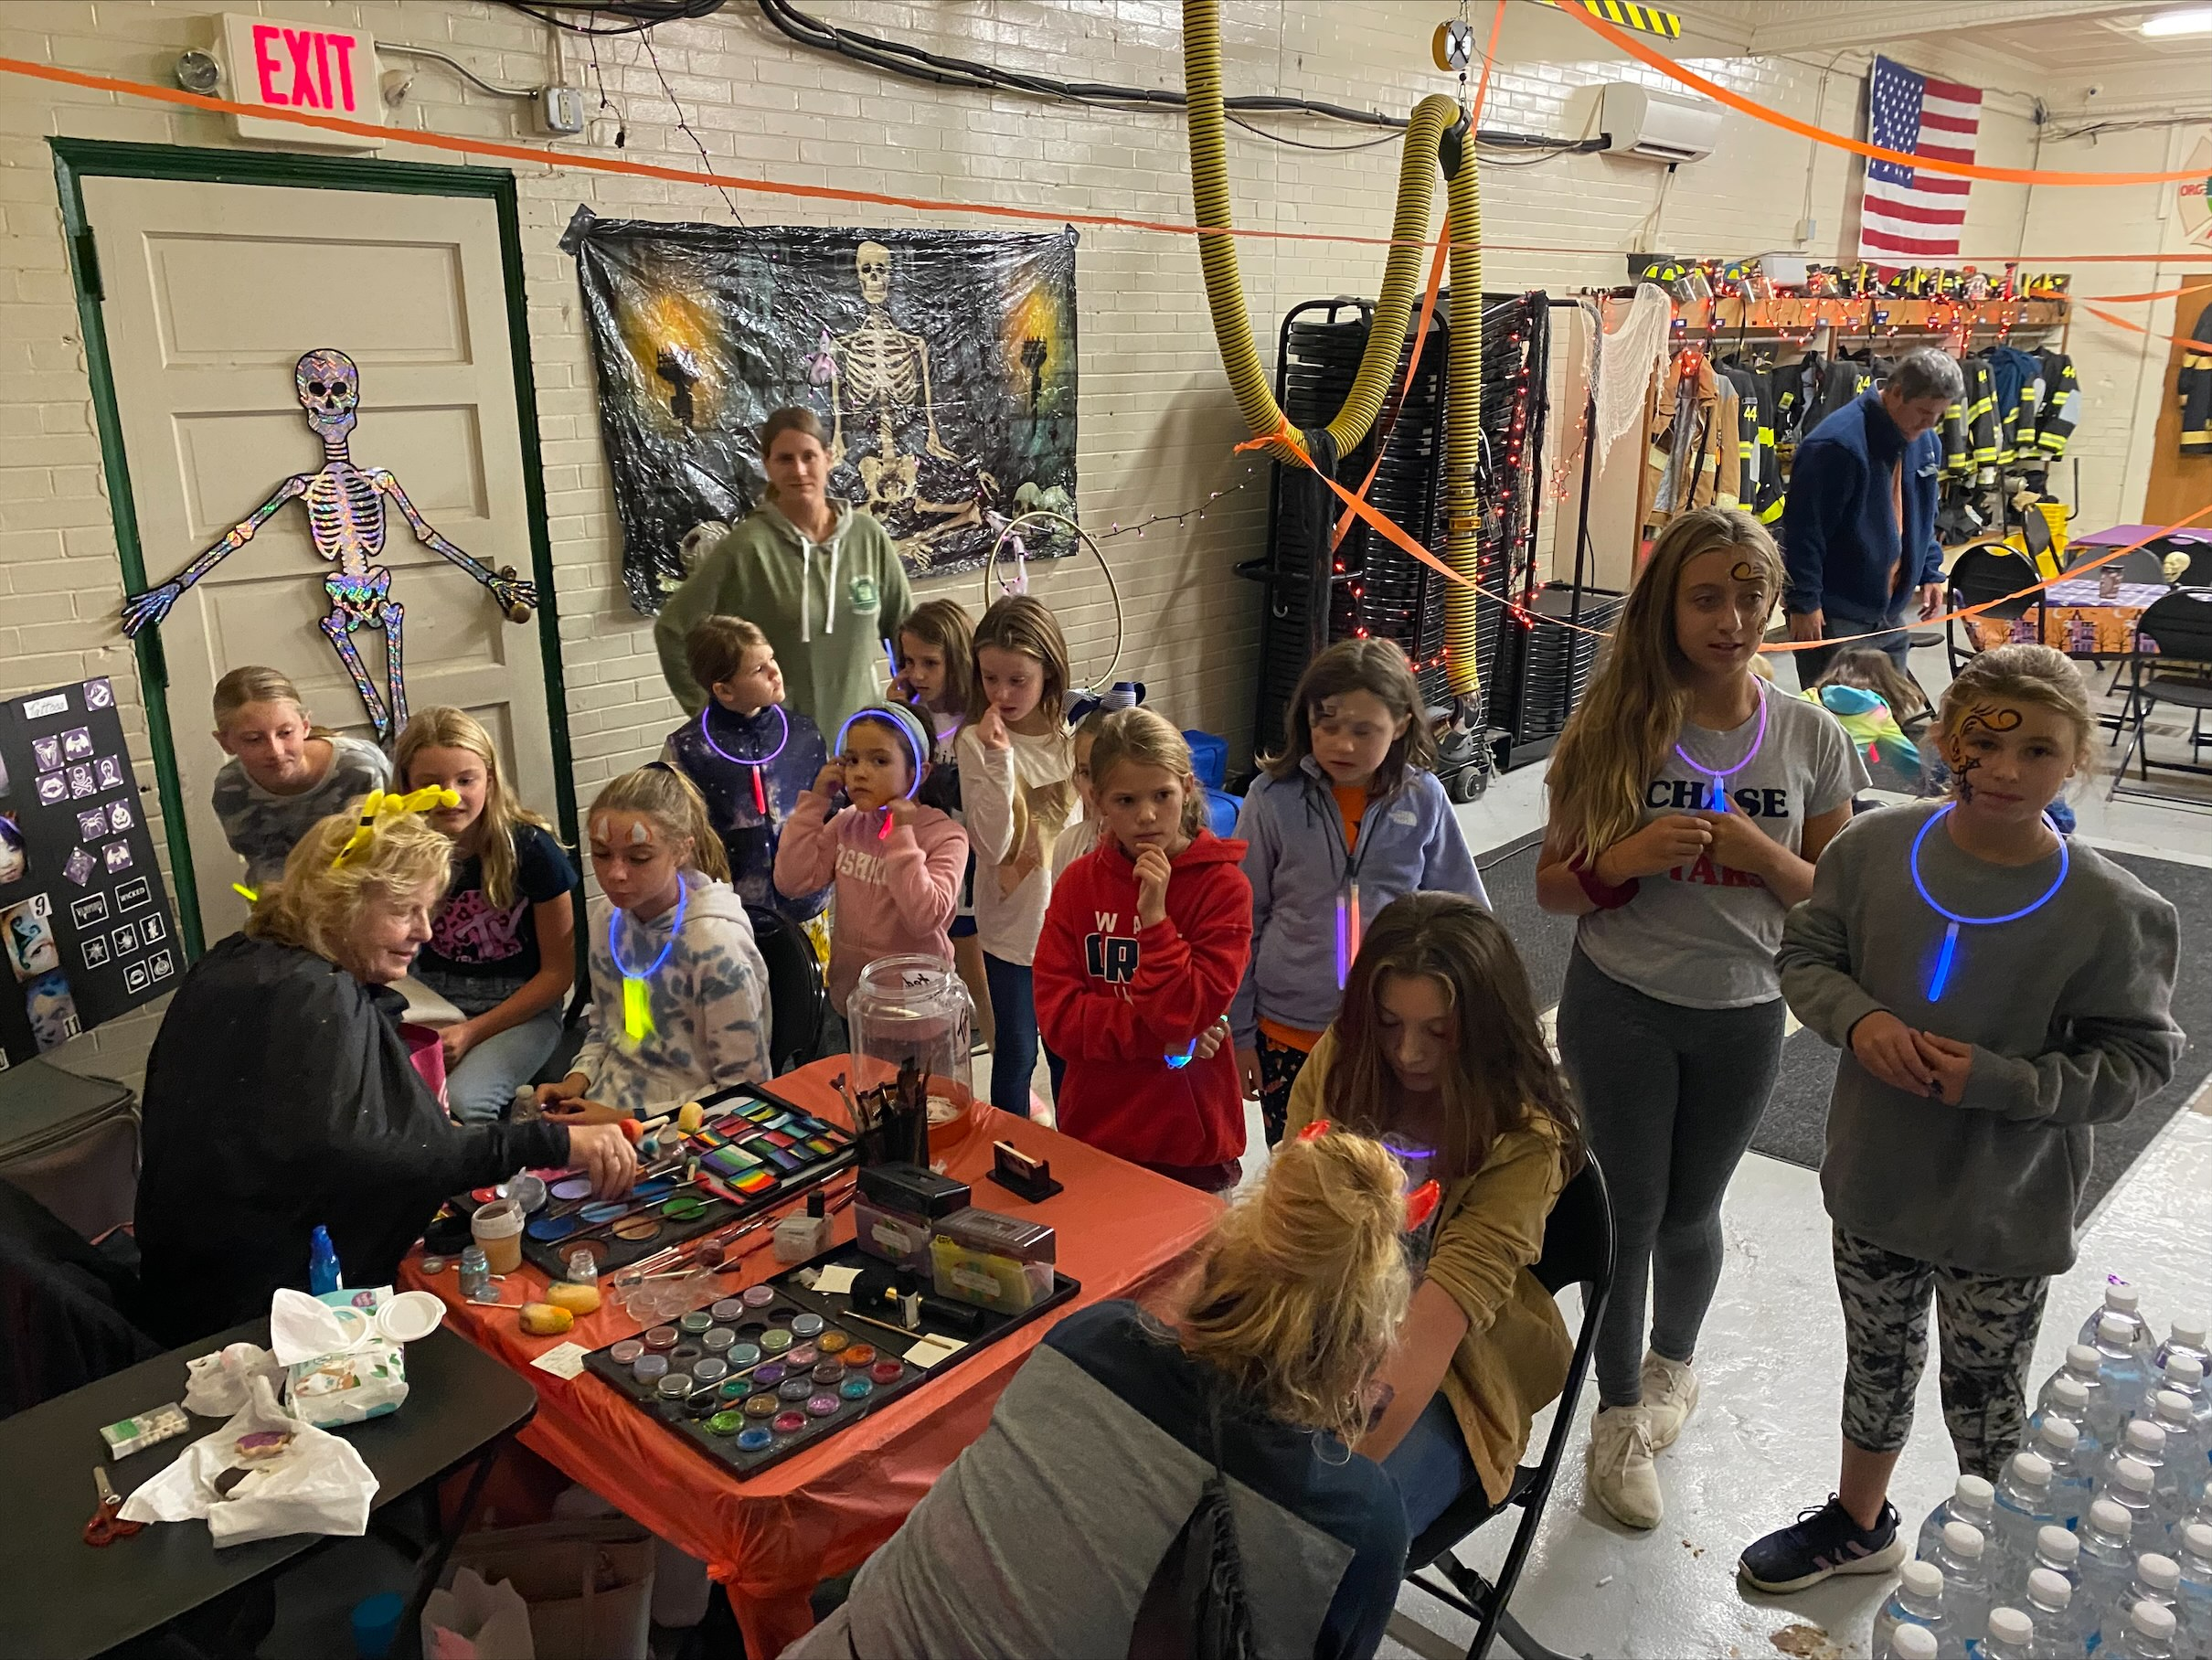

Slide 53
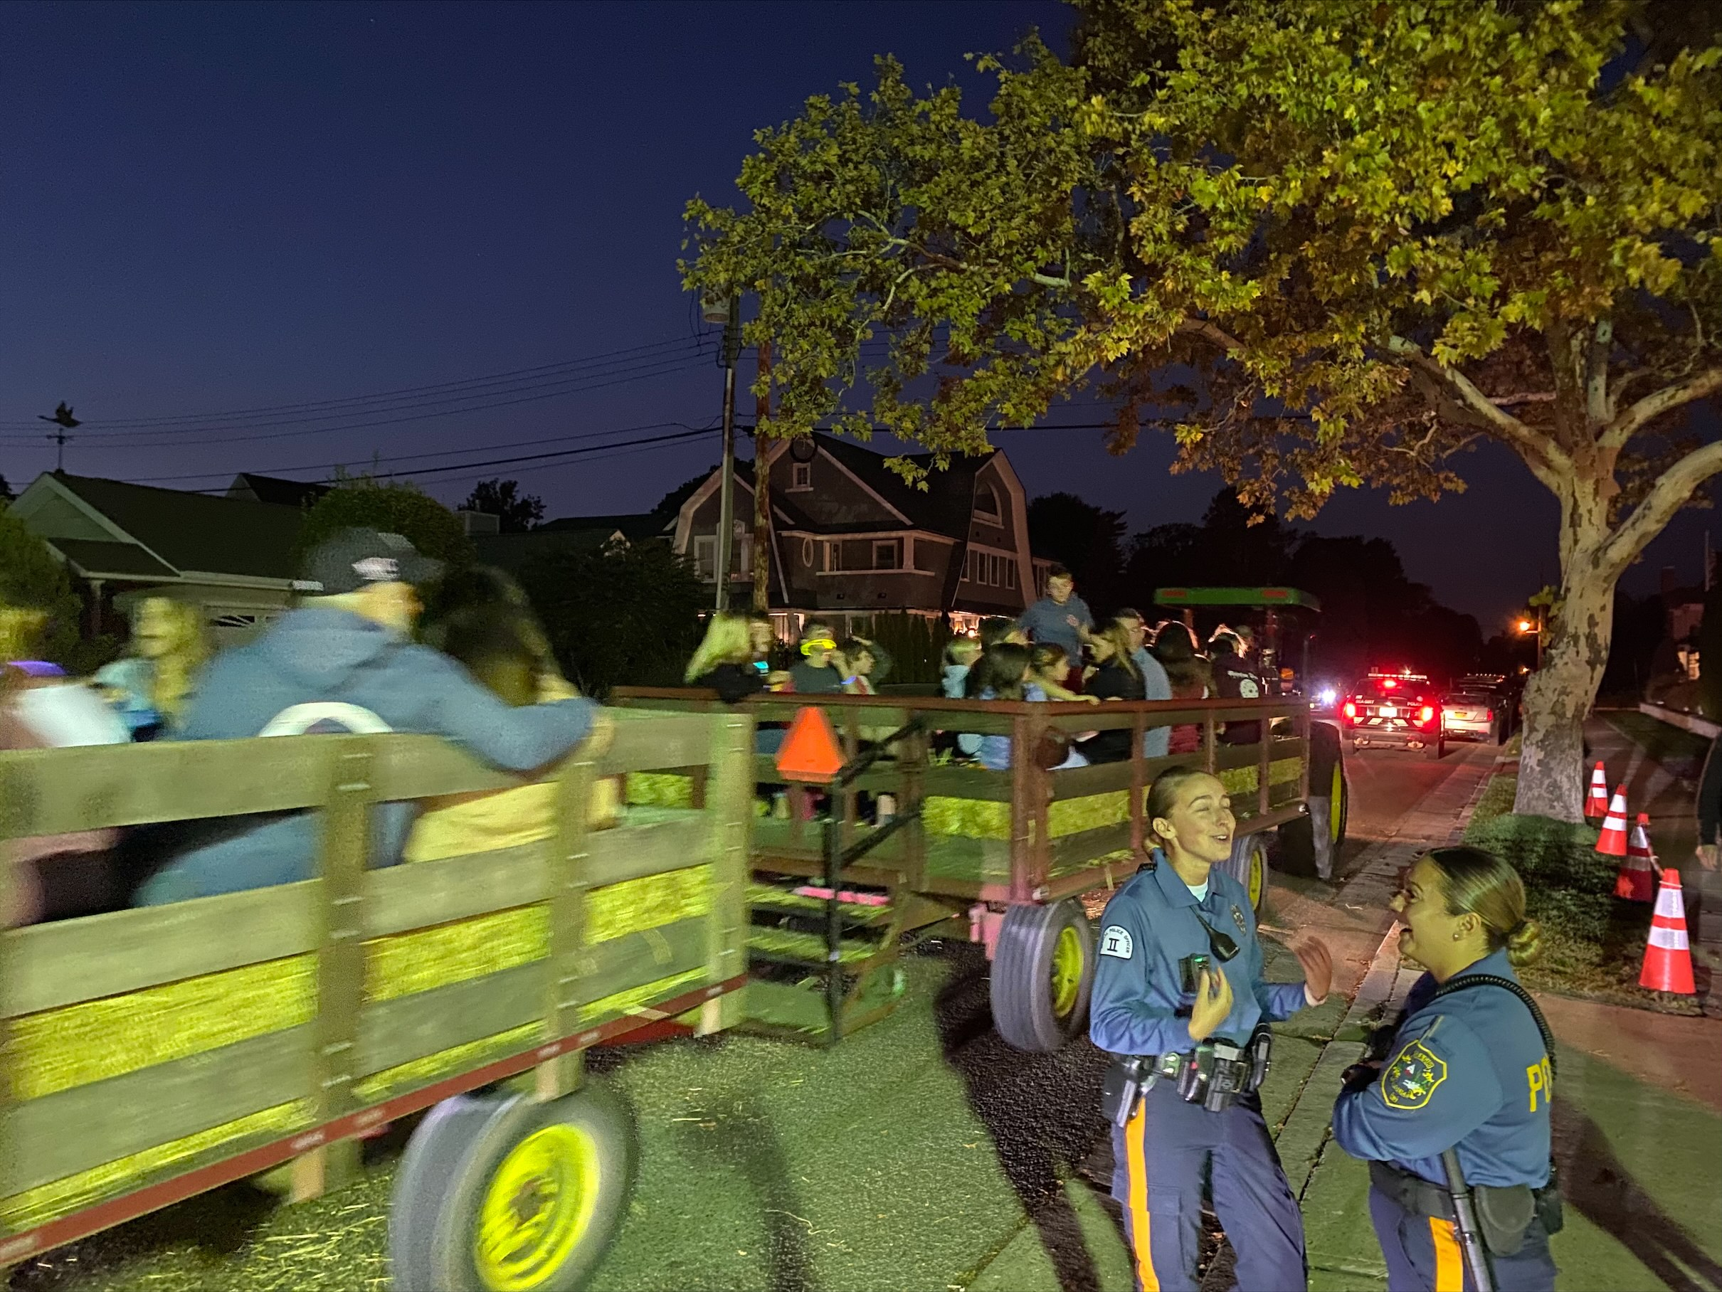

Slide 54
Downtown Advocate Role Building Partnerships – SG Chamber, Conservancy, Police, Fire Dept. PTO, Library, Lifeguards, SGES, Churches… Charitable Giving: - Cornhole Tournament at Reef & Barrel to benefit Fulfill Foodbank - Donations to Sea Girt Elementary Pickleball Equipment/Groundskeeping - Big Band Concert/Strolls

Slide 55
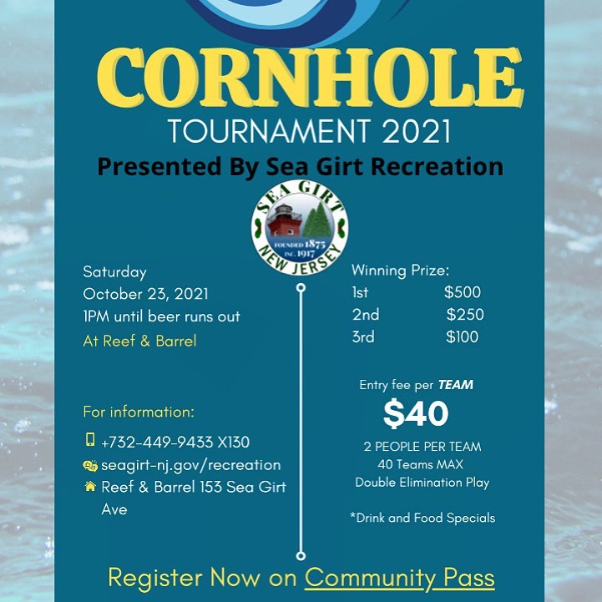

Slide 56
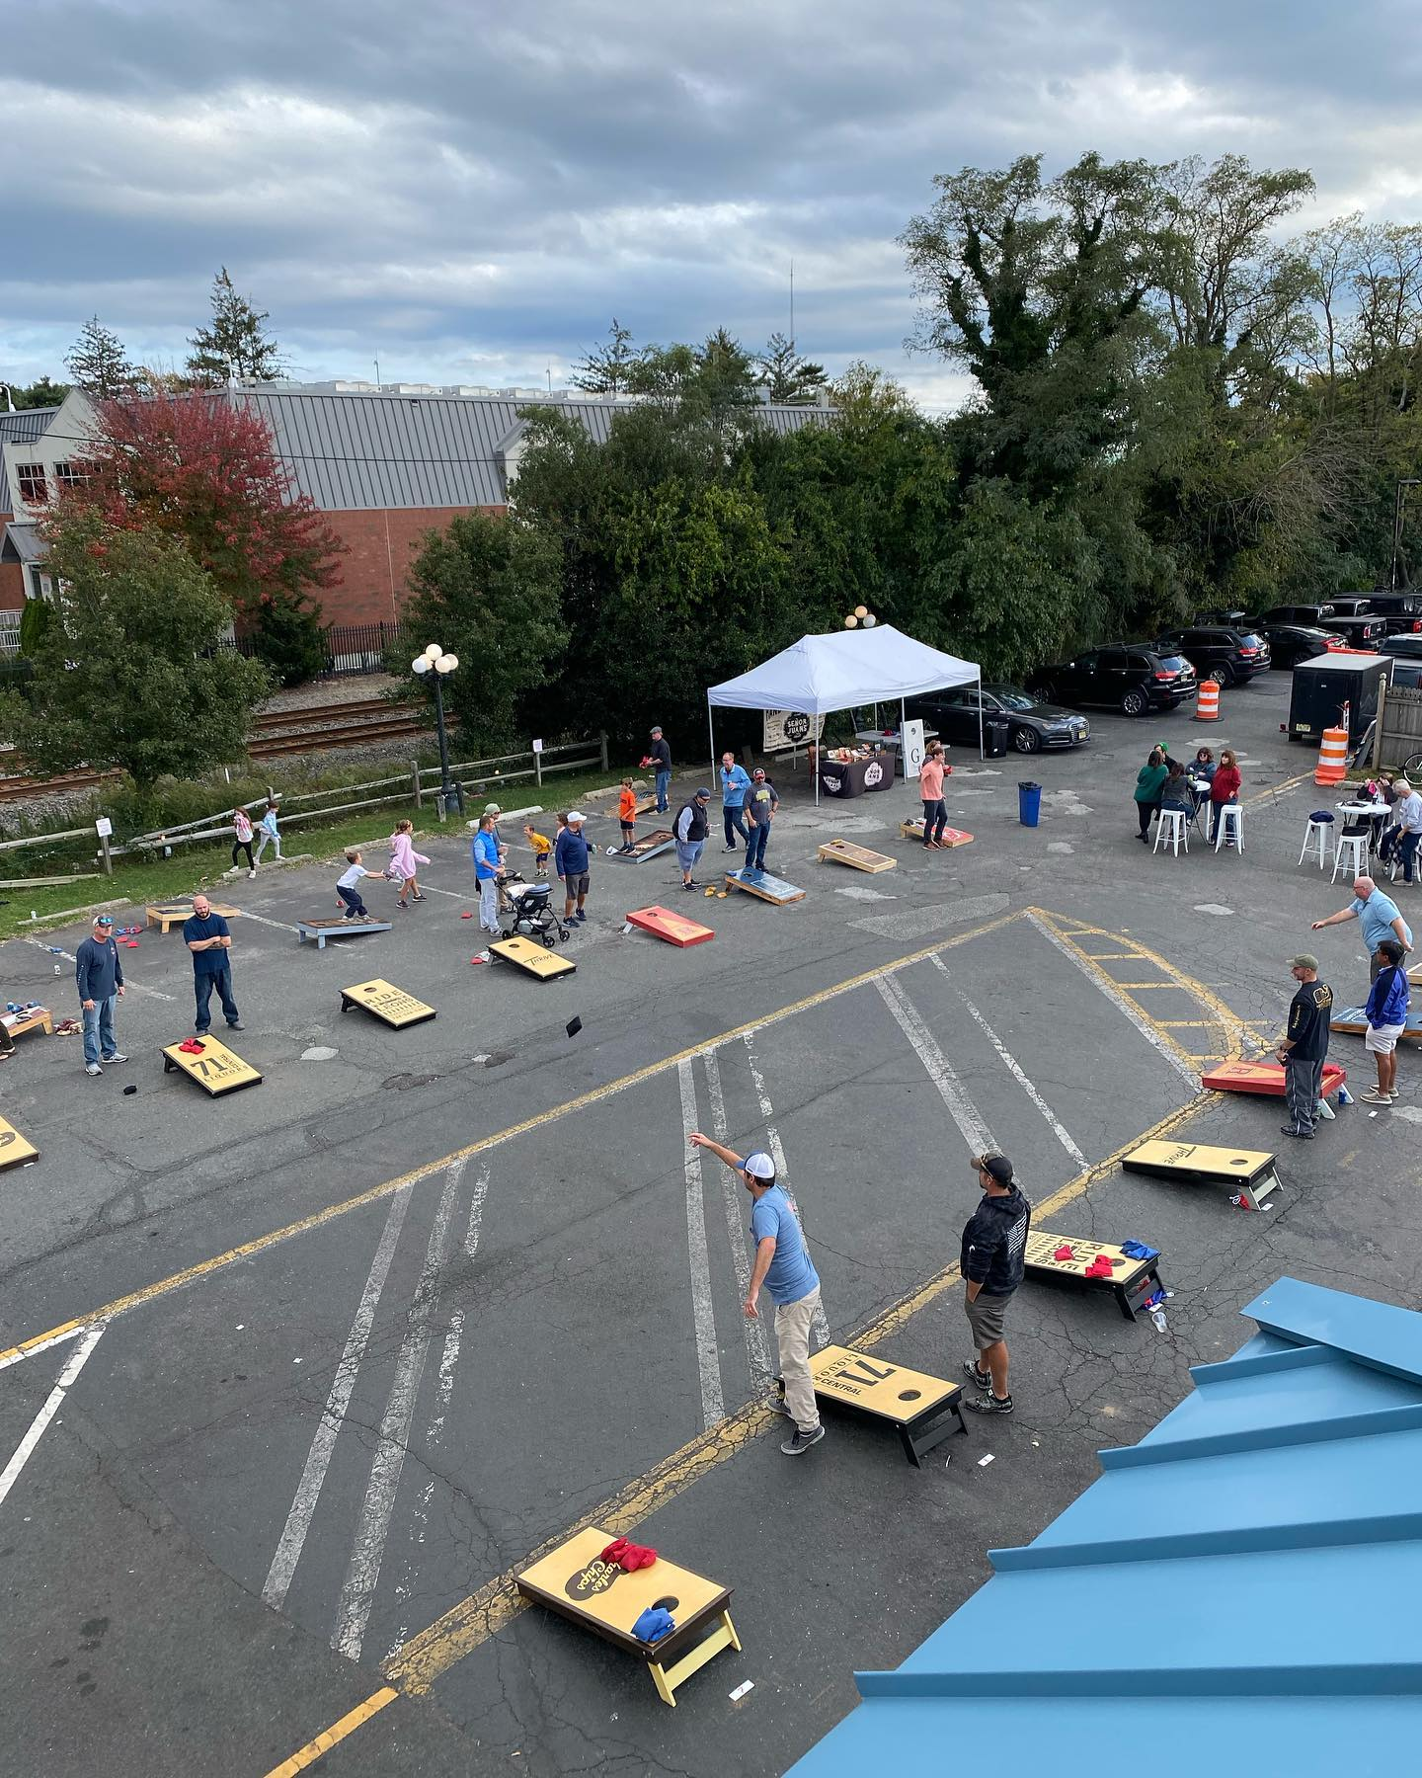

Slide 57
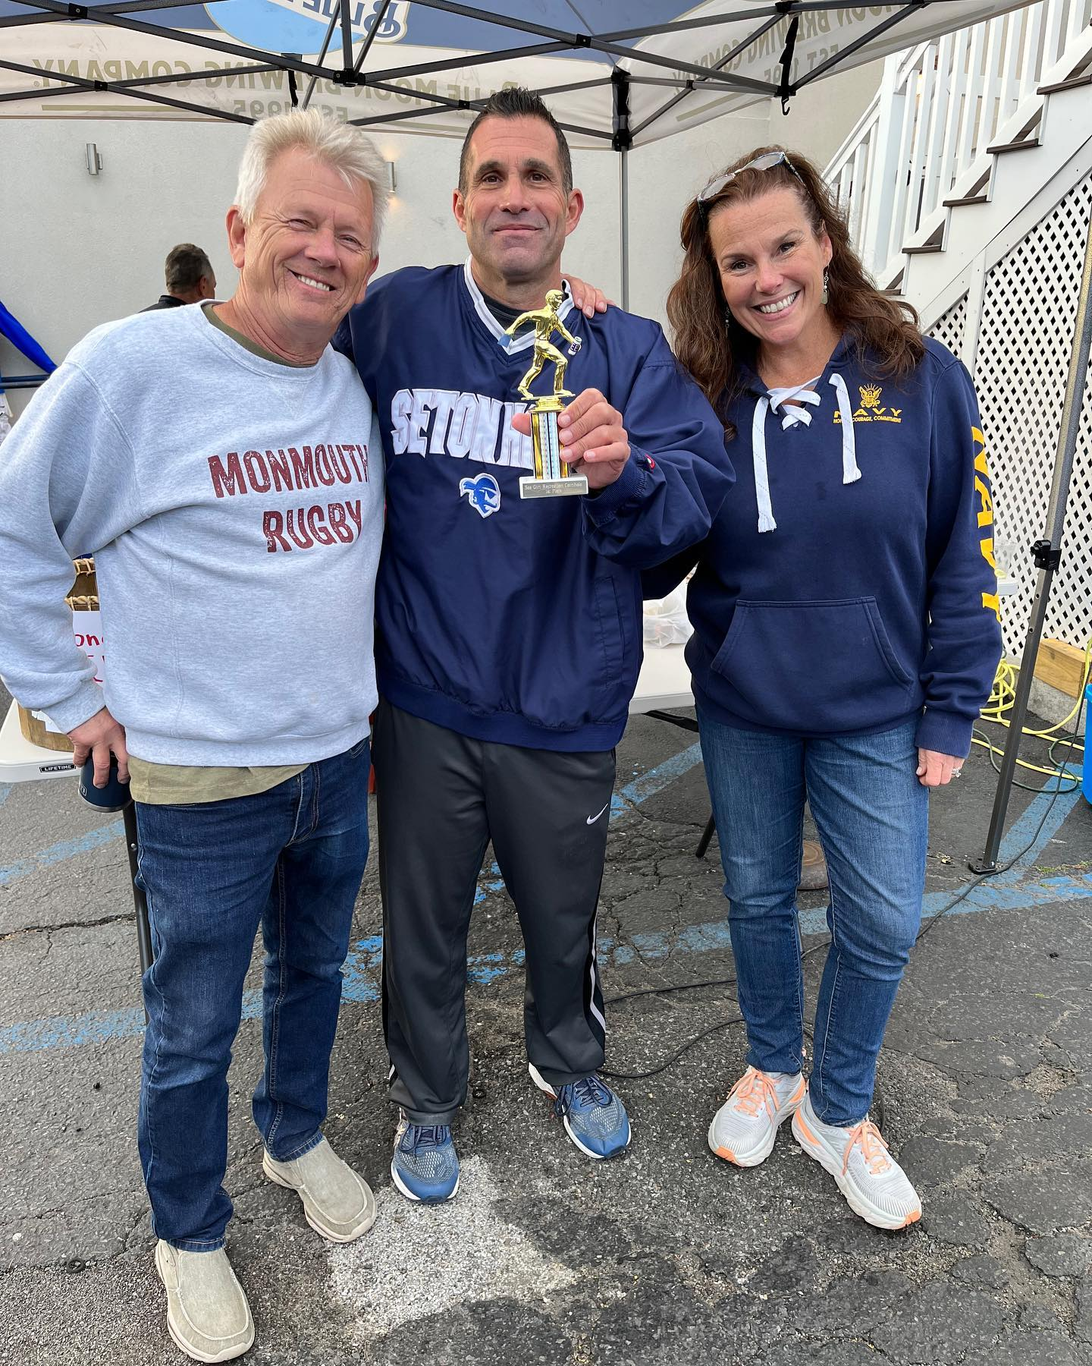

Slide 58
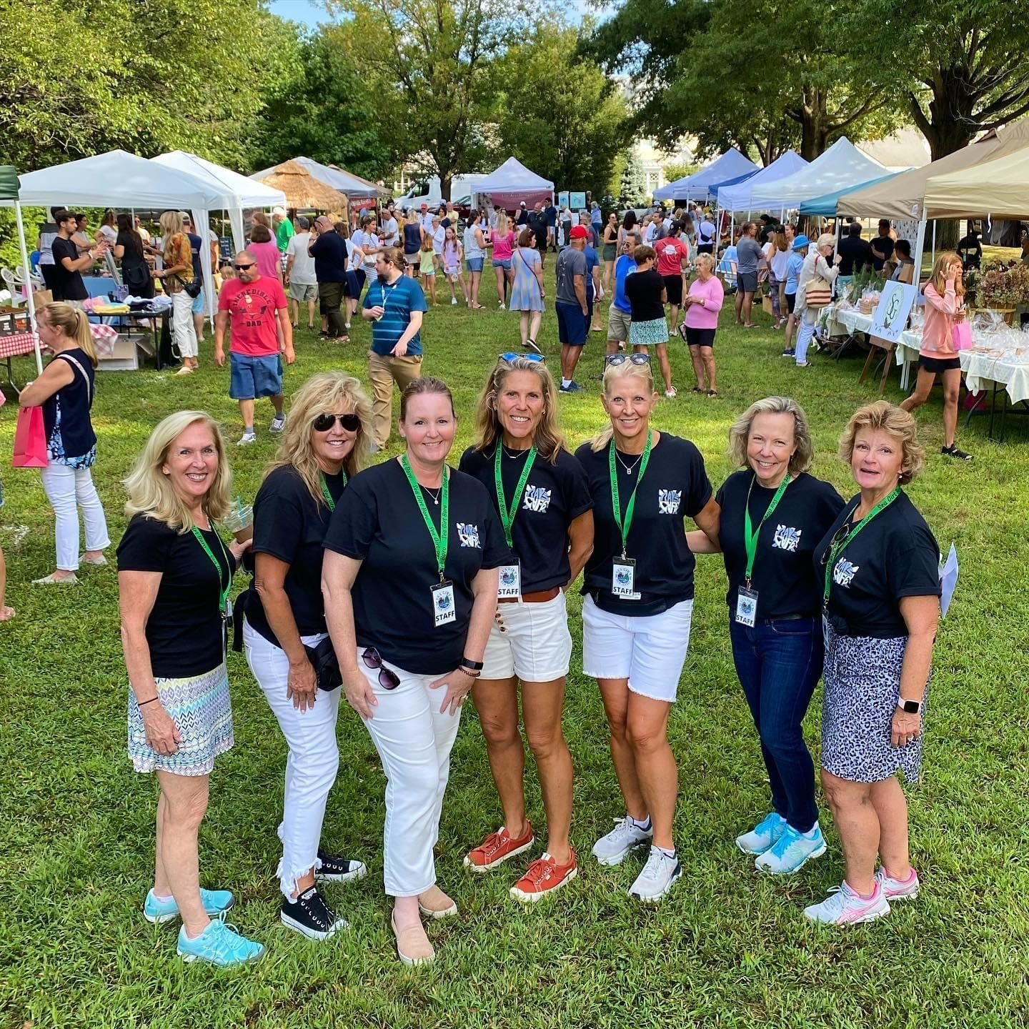

Slide 59
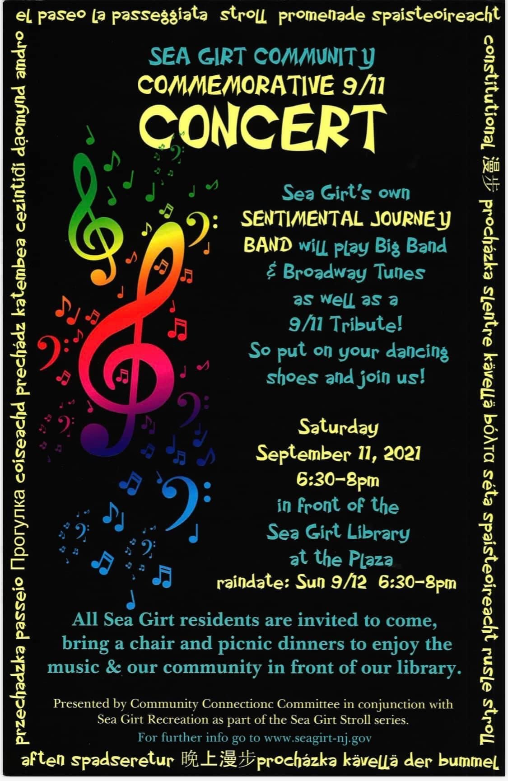

Slide 60
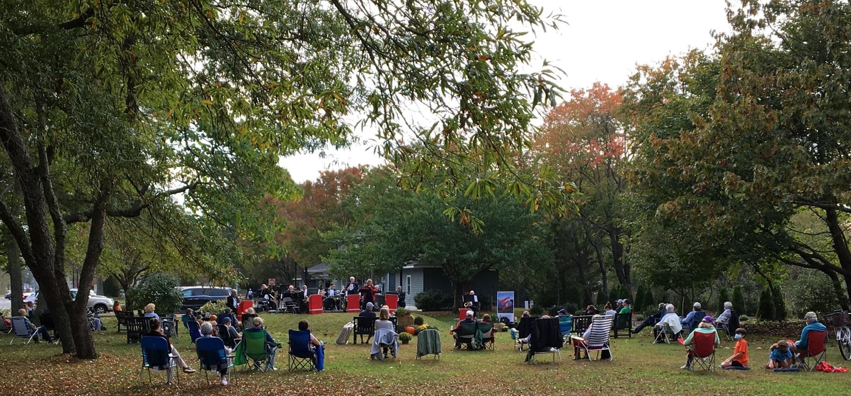

Slide 61
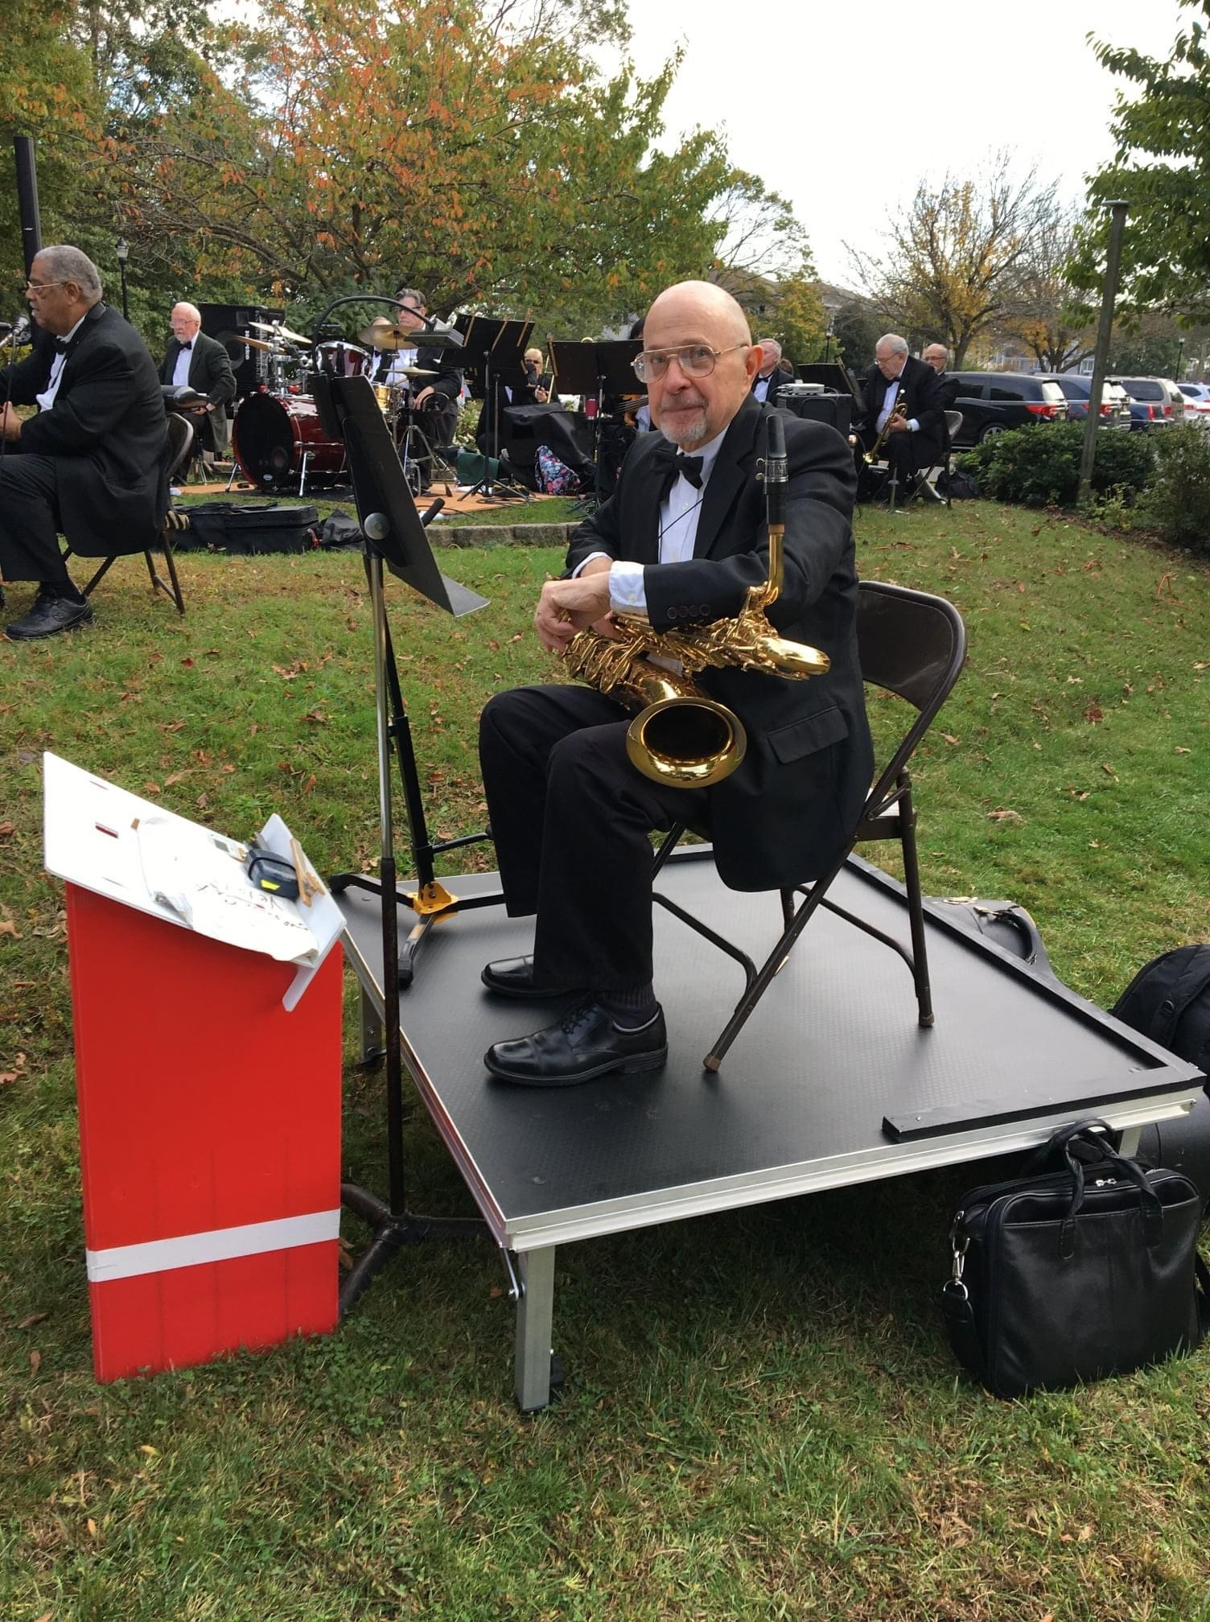

Slide 62
Upcoming Events!

Slide 66
Goal for our Programs – create recreational and educational opportunities, provide health and wellness experiences, bring people together, foster relationships, promote enjoyment, laughs and fun!

Slide 67
Sea Girt Recreation Improvement Projects - Resurfacing of Baltimore Park Basketball Courts - Resurfacing of Crescent Park Tennis Courts - Pickleball court lines and nets at Crescent Park and Sea Girt Elementary - Trees along Bell Place Tennis Courts

Slide 68
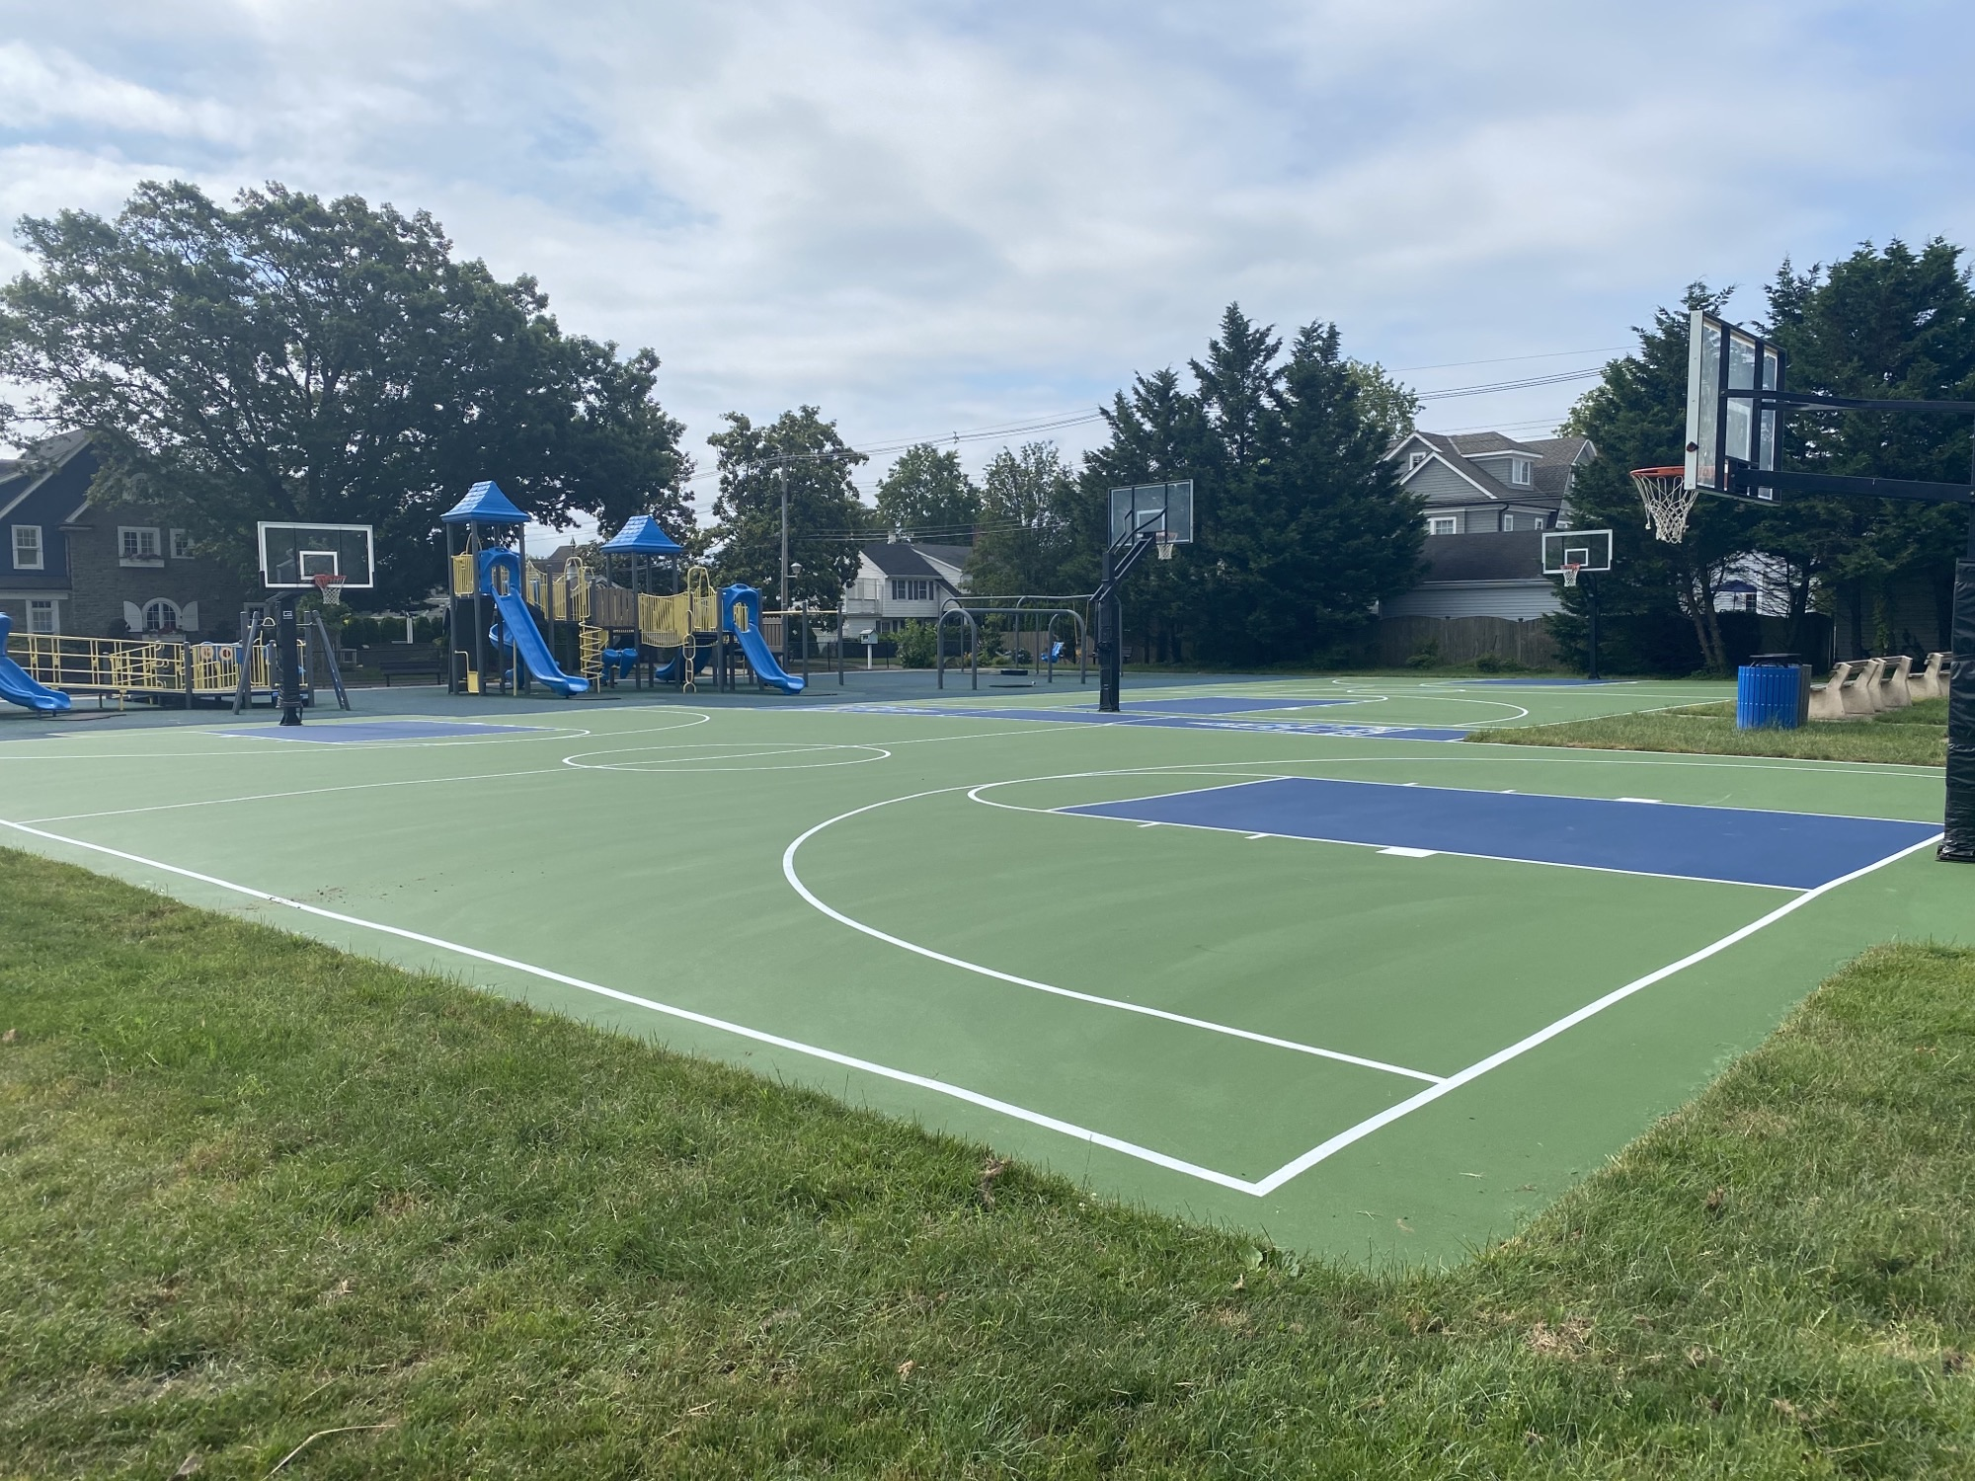

Slide 69
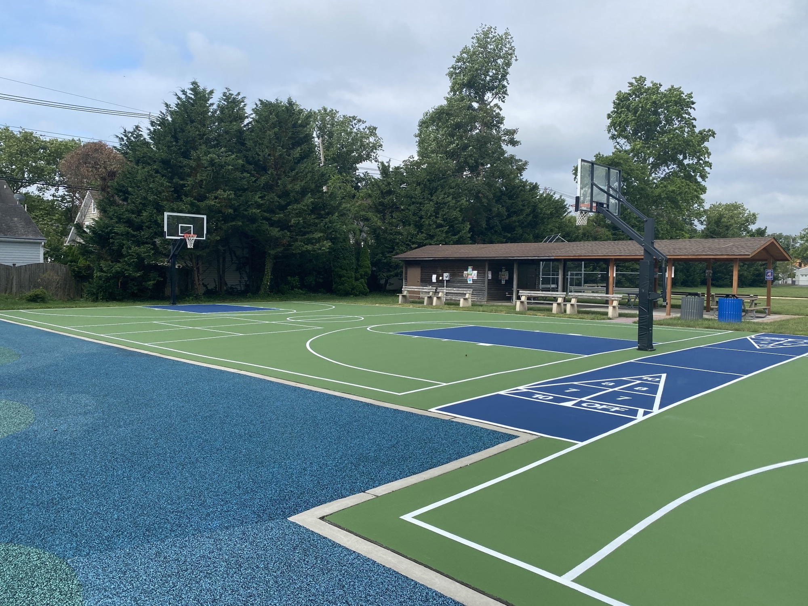

Slide 77
Rehabilitation/Improvements at Baltimore Park - Extension of Pavilion Structure - Installation of rubberized playground surface - New Plantings/Berm along road - Soccer Field Benches - New T-ball infield and benches

Slide 85
Current Project: 2nd Paddle Court in Crescent Park Why a 2nd paddle court? - Listening to requests of residents - Desire for another court, inability to book court at popular times - Need for outdoor year-round recreation - Increased usage – permits and reservations - Opportunity for more residents to learn and play: Instructional Clinics, Leagues, Round Robin

Slide 87
- 2nd court allows for expanded instructional programs for children and beginners Example: Paddle clinic for children in Feb, 2 sessions, 6 kids each. Filled up in 2 days. (Sea Girt children only)

Slide 89
Tennis Court Usage and Permit Fees Collected 5 Courts (2 Pickleball) 2019 Tennis Permits: 20 – 12 Family, 8 Individual (56 resident impact w/4 person family) Reservations: 379 (76 per court) Fees Collected $2,030 2020 Tennis Permits: 78 – 50 Family, 28 Individual (228 resident impact) Reservations: 1380 (276 per court) includes pickleball Fees Collected: $7,570 2021 Tennis/Pickleball Permits: 93 – 51 Family, 42 Individual (246 resident impact) Tennis Reservations: 1133 YTD (226 per court) Pickleball: 873 YTD (437 per court) Fees Collected: $8,605

Slide 90
Pickleball’s increase in popularity - Residents requesting more courts and instruction - Introduction of Pickleball Clinics Patty Criscenzo and Now Scott Forest - Addition of two more pickleball courts at SGES* Now 4 pickleball courts in town

Slide 95
Paddle Court Usage and Permit Fees Collected Single Court 2019 Paddle Permits: 34 – 20 Family, 14 Individual (94 Resident Impact) 246 Reservations Made Fees Collected: $3,200 2020 Paddle Permits: 57 - 30 Family, 27 Individual (147 Resident Impact) 681 Reservations Fees Collected: $5,205 2021 Paddle Permits: 62 – 38 Family, 24 Individual (176 Resident Impact) 712 Reservations YTD Fees Collected $5,815

Slide 96
2021 YTD Summary: Tennis/Pickle: 18.6 permits per court (93 Permits) $1,721 Fees per court Tennis: 226 Reservations per court Pickleball: 437 Reservations per court Paddle: 62 Permits per court $5,815 Fees per court 712 Reservations per court YTD

Slide 97
Behind the numbers Guests/Procrastinators/Cheap Skates

Slide 98
Crescent Park – Passive and Active Recreation for over 100 years Current Recreation Status:
3 Tennis Courts including 2 Pickleball Courts, 1 Paddle Court
New path cut in through woods for passive recreation
Roadway redone and rerouted (trees removed)
Invasive non-native vines
Improve and maintain the park for generations to come for both active and passive recreation.

Slide 99
Why Crescent Park for a 2nd Paddle Court? - Town officials selected this location for the first paddle court as the most advantageous to the community. In a park, setting designated for active recreational use, secluded area, used for this purpose for decades. 2nd court is a natural extension of this. - Location next to existing paddle court makes most sense in town - Ease of installation, upkeep and maintenance - electric, gas lines already run from street - Allows for instruction and play across 2 adjacent courts. (i.e. Round Robin/Beginners Clinics/Mixed Doubles League) - Next to existing tennis/pickle courts - completes an existing rec sports area - Baltimore Park already completely built out with space allotted for playing fields, courts, covered pavilion, and playground space. Not currently lit for night-time play. No existing gas hookup. No barrier/wind break - Bell Place Park/Path area being kept as green space, new bike path to be installed. Close proximity to route 71. No rec facilities/lights for night play.

Slide 105
June 15, 2006

Slide 106
Borough Council Meeting Minutes 2005

Slide 108
Review of the project specifications: Single 30’ x 60’ paddle court with a viewing deck connecting the existing court to the new court Area impacted represents approximately 0.32% of the park’s 17 acres. An estimated 10 trees are impacted to be replaced by a minimum of 20 43,560 sq. ft/acre x 17 acres = 740,520 total sq. ft. Estimated 2500 sq. ft. for project = 0.32% Project does not include construction of bathrooms, indoor structures, or any parking area.

Slide 109
Statement from the Recreation Commission:
The 2nd paddle court project is the completion of an active recreation area within Crescent Park. The current Recreation Commission will not seek to expand the footprint of the active recreational area nor add any structures in Crescent Park after this project.

Slide 110
What about wildlife?
Crescent Park Forest Stewardship Plan –
June 4, 2021 Amendment
“The installation of an additional Platform tennis court is expected to disturb 2500 square feet or 0.32% of the property in an area that is between the parking lot and the existing Platform tennis court. The minor disturbance is expected to have no impact to any Threatened and Endangered species.”
Bill Brash, NJ Approved Forester, Licensed Tree Expert

Slide 112
Does this project benefit only a segment of Sea Girt Residents? Of course, generally all projects do. Individual segments use certain facilities. Ex. Bike Path Project/Basketball Courts/Playground/Tennis Courts/Pickleball Each project/program will benefit different groups

Slide 115
Aligning With Sea Girt’s Long Term Recreational Objectives
Sea Girt Master Plan (Excerpt)
“Encourage the development of active and passive recreation opportunities that meet the needs of year-round residents and visitors alike;”
Sea Girt Stewardship Plan (Excerpt)
“Today, the park remains an integral piece of open space for passive and active recreation…”
“0.32% of the woodlands will be removed from the FSP (Forest Stewardship Plan) for the purposes of installing an additional Platform tennis court. See map of proposed revision on page 19 (last page). No other changes are anticipated and all goals and objectives as originally set are still proposed.
Sea Girt Recreation Mission Statement (Excerpt)
“The Commission's purpose is to oversee the Borough's parks and recreational facilities as well as develop and administer recreational programs with a broad appeal to all members of the community. The Borough's recreational facilities include Baltimore Park, Crescent Park, with its tennis courts and paddle court, as well as the Bell Place tennis courts.”

Slide 116
How was public made aware of this project? What entities were consulted? Presentations at two Borough Council Meetings (Feb. and August). Additional meetings addresses Stewardship Plan - Scope, size, justification, discussed in detail, open to public review and comment Discussions and on-site meetings with Sea Girt Shade Tree Commission and Sea Girt Conservancy Members Review, update and amendment of Stewardship Forest Plan by NJ Approved Forrester inclusive of project Discussions with SG Fire Department and SG Police regarding parking and access

Slide 117
Coast Star Feb. 25, 2021

Slide 118
Coast Star August 19th, 2021

Slide 119
Two Zoom meetings with Carriage Way neighbors to address potential concerns, plus numerous in-person one on one meetings, phone calls, etc. Issues discussed included: - Court locations/orientation - Light/Noise Mitigation - Trees - Parking

Slide 123
What about the trees? - Planting of trees to replace any removed – minimum 2x - Species and location of new tree plantings by Shade Tree Commission and Sea Girt Conservancy - Show of good faith - Recreation Commission will donate additional trees now. (Not part of the 2x Tree Replacement) Matching gift tree program - $2,000 initial donation. ($100 per tree, 40 tree goal)

Slide 125
The Sea Girt Conservancy supports the proposed plan for the addition of a paddle ball court to Crescent Park. It will provide a needed benefit to our community, while also increasing the utility and quality of passive recreation in the park, in furtherance of our mission: to promote the preservation, enjoyment, and ongoing maintenance of our parks and open space for the environment and the benefit of the public, thus ensuring the continuation of these valuable resources for current and future generations.
We make this endorsement with the conditions that the plan does not conflict with any existing agreements regarding Crescent Park, and that the plan satisfies a legal review by the Borough.
- Alan Zakin, Chairman

Slide 128
Major issue facing Crescent Park - Invasive Non-Native Vines (English Ivy) Solutions: - Removal of vines, treatment of vine root systems, and removal of some trees threatening specimen trees (Holly) - Planting of desirable native tree species

Slide 129
“Monoculture of Holly” in Crescent Park
Crescent Park is reaching a climax condition - characterized by the position of American holly in the overstory. American holly is quite shade tolerant, meaning that it can germinate and persist under the canopy of other trees. It then maintains a slow and steady growth pattern, eventually replacing other trees as they die. At Crescent Park, remnants of an earlier community of oak, cherry, sassafras and red cedar remain in pockets, but are mostly decreasing because of their inability to reproduce under the dense shade. Many of the largest stems in this forest are oaks that have recently died, or are in severe decline. Many cherries and sassafras can also be found in decline or already dead. Over time, holly continues to gradually occupy more and more of the stand's growing space, converting the forest from an assemblage of mixed upland species to what is essentially a monoculture of holly.

Slide 130
Goal of the Rec Commission is to work with Shade Tree Commission and Sea Girt Conservancy to assist with overall improvements to Crescent Park - Help with vine removal projects - Donate desirable trees to be planted - Promote awareness of the park - Improve sitting area/walkway by tennis courts

Slide 149
2nd Paddle Court Project - Requested by Full-Time, Year Round Residents - Demand supported by permit and reservation data - Unanimously Approved by Recreation Commission - Unanimously Approved by Borough Council - Supported by Sea Girt Conservancy - Cooperation/No objections by Shade Tree Commission - Extensive public notification/opportunity for feedback - Carriage Way Neighbors consulted and plan modifications made - Aligns with Forest Stewardship Plan written by NJ Approved Forester. 0.32% “Minor disturbance expected to have no impact to wildlife” - Reviewed by Sea Girt Fire and Police for Traffic/Access

Slide 150
Current Status of Project - Engineering, Bid Specification Phase - Next Step: Engineering and Bid Review/Award to be voted on by Council at future council meeting Funded through the Sea Girt Recreation Trust - Current Recreation Trust Balance: $200,802.40

Slide 151
Common theme: We all love Crescent Park! Overview: This project will provide additional recreational opportunities and socialization for borough residents year-round with an extremely small impact on the surroundings. The completion of this area, discussed for many years, will allow for more residents to exercise, create experiences, have fun, laugh and make memories. The health and wellness benefits to residents greatly outweigh the minor impact in the context of the park in its’ entirety. Let’s work together as a community to truly improve the park we all love for the greater good and enjoyment of all, for both active and passive recreation.

